Slide 1
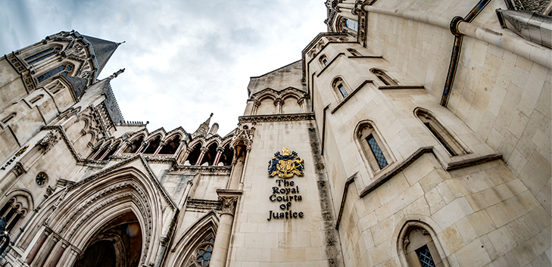
Judicial Review and Strategic Litigation for Charities, NGOs and Campaign Groups: Practical Steps in Judicial Review Oliver Carter, Irwin Mitchell 25 January 2023

Slide 2
Practical steps in judicial review
Time limit
Pre-action protocol
Application for permission
Substantive hearing
Funding and costs
For further information, see:
Pre-action protocol for judicial review
Civil Procedure Rule 54 and Practice Direction 54A
The Administrative Court Judicial Review Guide

Slide 3
Time limit for judicial review
You must act quickly:
Any application for judicial review must be filed at court promptly and in any event not later than three months after the grounds to make the claim first arose*
- CPR 54.5
(*Unless a shorter time limit is specified, e.g. six weeks in planning cases)

Slide 4
The process of bringing a judicial review
Step 1: Identify the decision: what is the decision, who took it, when and how was it taken
Step 2: Funding: how will the case be funded? e.g. legal aid, crowdfunding, private funding
Step 3: Pre-action stage: send a pre-action letter to the Defendant setting out the facts and legal arguments. A response must usually be provided within 14 days

Slide 5
The process of bringing a judicial review
Step 4: Apply for permission: apply to the court for ‘permission’ to bring a judicial review (and for interim relief if urgent action is needed, e.g. an injunction)
Claimant files claim form, statement of facts and grounds, any witness statements, relevant documents or correspondence, pays court fee (£154), then serves issued claim within 7 days
Within 21 days, the Defendant files acknowledgment of service and summary grounds of defence
The papers are then passed to a judge to consider permission

Slide 6
The process of bringing a judicial review
Step 5: Permission: a judge will consider whether the case has ‘arguable’ grounds. If it does, the judge will grant permission to proceed to a final hearing. Claimant then to pay court fee of £770. Within 35 days, the Defendant files detailed grounds of defence
(Step 5a: Permission refused: if permission is refused ‘on the papers’, you can apply for an oral renewal hearing for this to be reconsidered – court fee of £385, deducted from fee above if permission is granted on renewal)

Slide 7
The process of bringing a judicial review
Step 6: Final hearing: the parties make legal arguments in court (oral witness evidence is rare), usually for one day The judge(s) will usually reserve judgment, i.e. hand down or deliver their judgment at a later date
Step 7: Costs: the court has discretion, but the general rule is that the unsuccessful party pays the successful party’s legal costs (CPR 44.2)

Slide 8
The process of bringing a judicial review
Step 8: Appeal: if your case is unsuccessful, you can apply for permission to appeal to the Court of Appeal Permission will only be granted if there is a real prospect of success or there is another compelling reason for the appeal to be heard
Step 9: Second appeal: if unsuccessful again, you can apply for permission to appeal to the Supreme Court

Slide 9
How can you fund a judicial review?
Legal aid is available if an individual is financially eligible (see civil legal aid eligibility keycard for summary). Legal aid protects against adverse costs if the case is unsuccessful
Crowdfunding – e.g. CrowdJustice
Private funding (including discounted agreements)
Pro bono

Slide 10
Cost capping orders
An application for a cost capping order may be only made by a claimant (i.e. not by a defendant, interested party or intervener) and must normally be made in the claim form, supported by evidence
A cost capping order may only be granted by the court after permission to apply for judicial review has been granted
A cost capping order:
Will usually limit the amount a claimant can be ordered to pay in respect of adverse costs if they lose; and
Must also limit the amount that a claimant can recover from a defendant if they win (but this need not be the same amount)

Slide 11
Cost capping orders
The court may only make a cost capping order if it is satisfied that:
The proceedings are public interest proceedings; and
In the absence of the order, the claimant would discontinue the application for judicial review or cease to participate in the proceedings; and
It would be reasonable to do so
(For more detail on cost capping orders in judicial review, see sections 88-90 of the Criminal Justice and Courts Act 2015)

Slide 12
Interveners and costs
An intervener’s costs will only be paid by another party in exceptional circumstances
Section 87 CJCA 2015: if another party applies for an intervener to pay any of their costs, the court must order an intervener to pay the costs incurred as a result of their involvement if:
The intervener has acted, in substance, as the sole or principal applicant, defendant, appellant or respondent;
The intervener’s evidence and representations, taken as a whole, have not been of significant assistance to the court;
A significant part of the intervener’s evidence and representations relates to matters that it is not necessary for the court to consider;
The intervener has behaved unreasonably

Slide 13
If the case is successful…
Winning in court will often mean the decision is overturned – but this does not stop the Defendant trying to ‘re-make’ the decision lawfully at a later date
Many judicial review cases settle before reaching court – the vast majority of cases do not reach a final hearing, and Defendants may back down after a pre-action letter, or when the court grants permission

Slide 14

Contact
Oliver Carter
Associate Solicitor
Public Law and Human Rights
Irwin Mitchell
Oliver.Carter@IrwinMitchell.com

