Slide 1



Slide 2
Developing strategies for influencing, messaging and gathering intel

Slide 3
What do we do?
Clue is in the name
We investigate abuses of power, corruption and inequality
TBIJ is a mission-driven organisation
We aim to spark positive change through journalism.
Notes:
Independent
Not for profit
Founded in 2010 by Elaine and David Potter
Started as a bulwark against diminishing time journalists can spend investigating
Shadow war project explored America’s murky military campaigns
We tracked strikes in Afganistan
Found out who was behind them and held the US military to account. Only admitted a handful of civilian deaths due to drone strikes and one time was after our investigation proving that the US had killed a child
We looked into police domestic violence which sparked other journalists and campaign groups to look into the issue.
Culminated in a super complaint to the police watchdog

Slide 4
Types of impact
Political impact
Legal impact
Law enforcement impact
Individual impact
Community impact
Public awareness impact

Slide 5
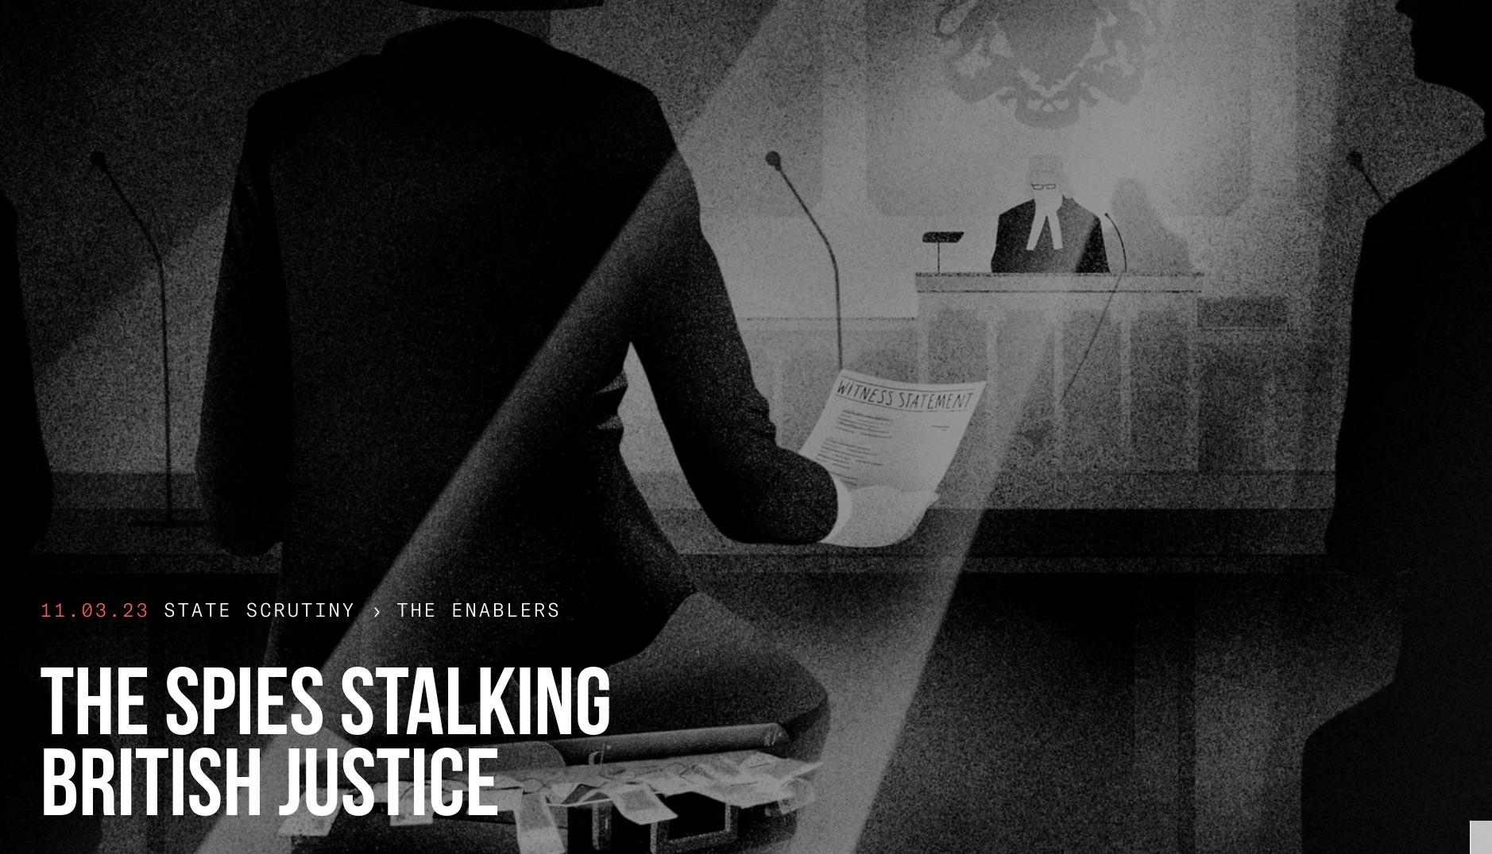
Notes:
We looked at how private investigators were offering hacking services
Undercover work in India
What we found out: witness payments, hacked material used in courts, investigators invading privacy, use of hacking malware
Briefing politicians inc shadow justice sec, questions asked in the chamber sparked Justice Secretary of State to ask to meet MP, private members bill,
UN - special rapporteur on the situation of human rights defenders, the Working Group on Arbitrary Detention and the Special Rapporteur on the promotion and protection of the right to freedom of opinion and expression - wrote to gov of Qatar, Germany and google re one of the targets. German gov has commenced criminal charges and put the target under police protection

Slide 6
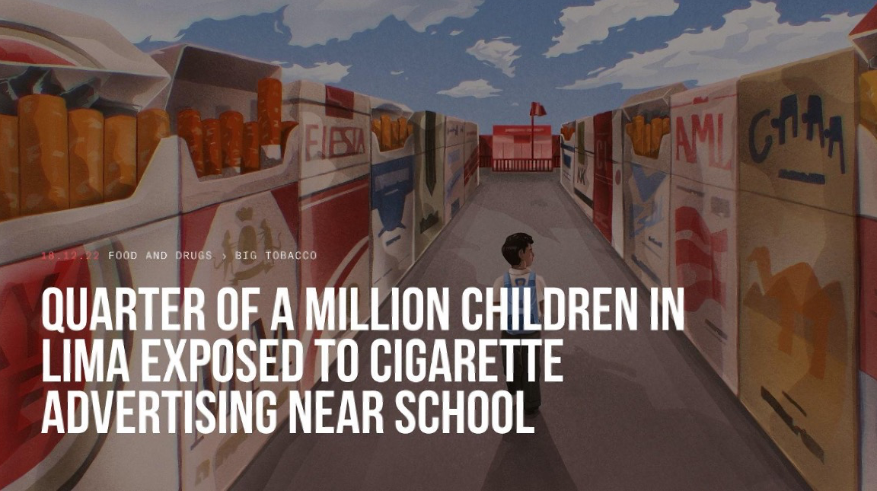
Notes:
Who - children and parents affected
Why - to educate and protect them
How - by engaging them in the investigation and local Peruvian paper
Crowdsourced data
Engaged school children in the investigation and asked them to take photos whenever they saw cigarettes being sold next to sweets in shops
The photos showed cigarette boxes spread in a rainbow of colours, surrounded by packets of sweets, chocolates and crisps; or open packs of cigarettes – most likely for people who want to buy singles – nestling within easy reach of children among bubblegum, cakes and soda.
Impact - thinking about the audience carefully
Used in Peruvian congressional discussions of an update to the tobacco control laws

Slide 7
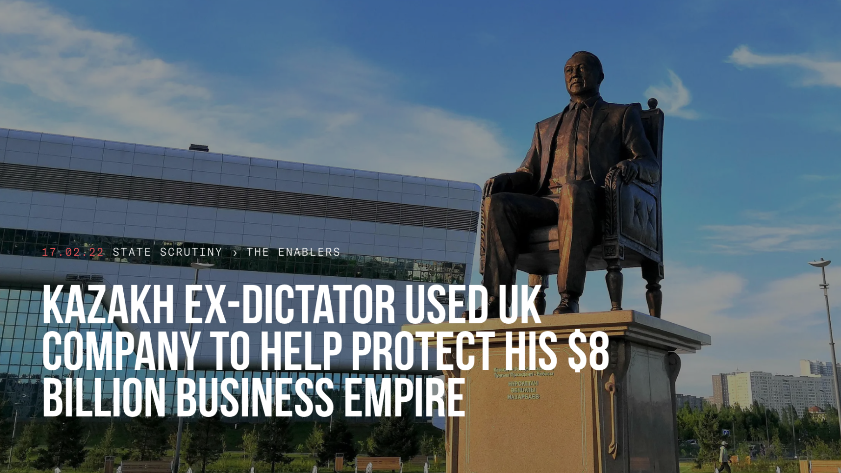
Notes:
LAWSUIT

Slide 8


Slide 9
Influencing
Parliamentary procedures
Committee, debates, briefings, events, APPGs, Qs, inquiries
Coalition collaboration
Parliamentarians relationships
Personalised approach, staffers key

Slide 10
Gathering intel
FOIs
What they know, keep it narrow, CFOI
Collaboration with community
Engagement, surveys, talking

Slide 11
Messaging
Keep it simple
Human stories most effective
Clear visuals
Think carefully about your audience:
Who do we want to reach?
Why do we need to reach them?
How do we want to reach them?

Slide 12
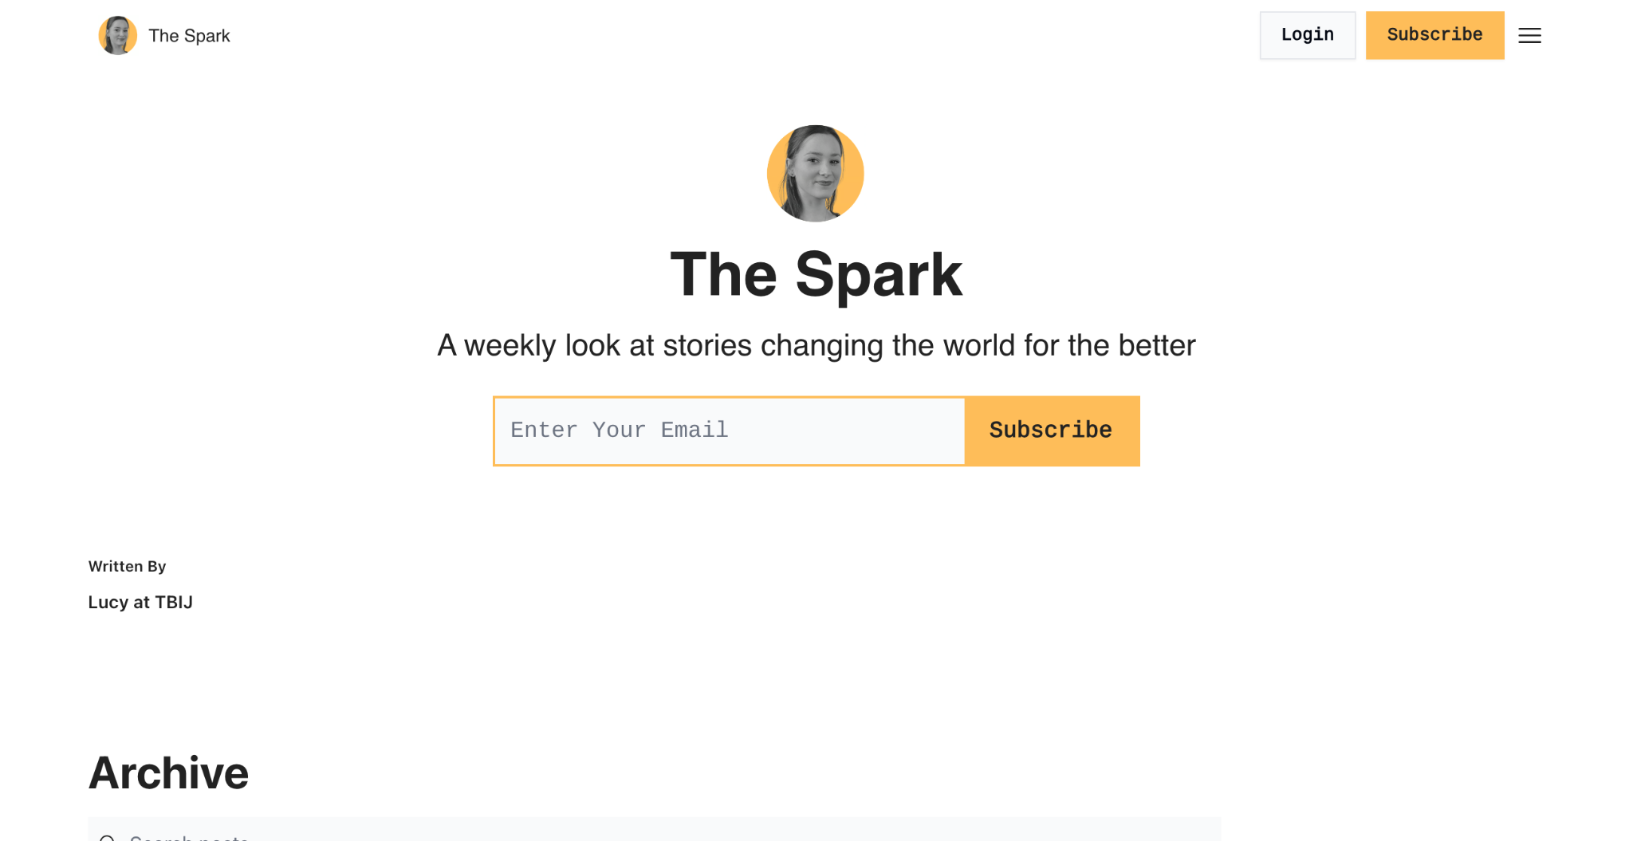
The Spark
Sign up link: https://the-spark-tbij.beehiiv.com/

Slide 13
Website thebureauinvestigates.com
Instagram @thebureauinvestigates
Twitter @tbij
lucynash@tbij.com
Any questions?
Notes:
CALLS TO ACTION

