Slide 1

Universal Credit suspensions
Investigating impact of automated decision making

Slide 2
CONTENTS
Overview of the case
Pre-litigation research and evidence collection
Pre-Action Protocol for Judicial Review

Slide 3
Overview of the case

Slide 4
What did we set out to investigate?
Unexplained suspensions of UC payments
Affected: clients with Pre-settled and Settles EUSS , Bulgarian nationals , single mothers
Suspicion of fraud, but payments reinstated in many cases
Lengthy delays in investigation with severe impact on our clients
Role of automated decision making and the Risk Review Team

Slide 5


Setting up the project
Notes:
Collaboration with Public Law Project
Work Rights Centre - Strategic Litigation Committee including two experienced barristers: Sadat Sayeed (Garden Court Chambers) and Miranda Butler (Landmark Chambers)
Funding from the Strategic Legal Fund for pre-litigation research

Slide 6
Pre-litigation research
and evidence collection

Slide 7

Collecting evidence of our clients’ issues
Case studies
Work Rights Centre client data
Universal Credit journals

Slide 8
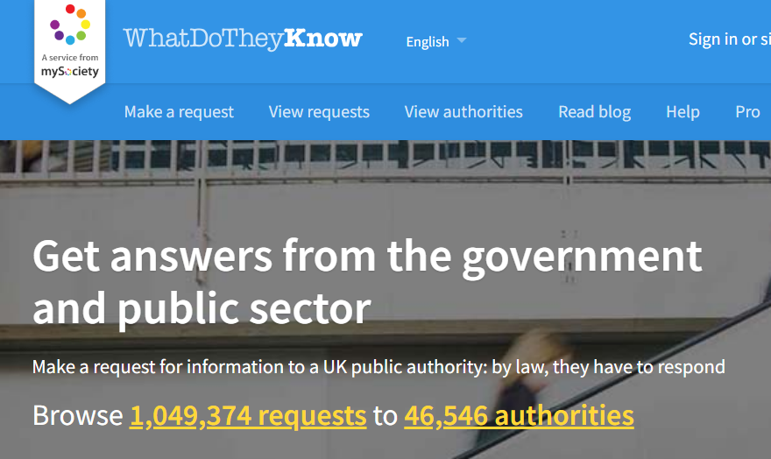
Research to build the wider picture
Public domain materials
Freedom of Information Requests
Parliamentary questions
Evidence from other organisations
in the sector

Slide 9
Pre-Action Protocol

Slide 10
Legal advice and issuing the PAP
Legal advice from the legal team at the Public Law Project
WoRC Strategic Litigation Trustee committee - support and oversight
Pre-Action Protocol for Judicial Review of the DWP’s: use of automation and data analytics to suspend payments of Universal Credit and/or to triage applications for advanced payment of Universal Credit

Slide 11
Multiple grounds for challenge
1. Failure to follow policy guidance, which states that suspension of benefit must be based on clear, genuine evidence and involve a human agent
2. Breach of the principle of transparency and/or breach of the duty of publication and/or systemic unfairness
3. Unlawful delegation and/or fettering of discretion
4. Breach of the UK GDPR
5. Discrimination contrary to the Equality Act 2010
6. Unlawful discrimination in breach of the European Convention on Human Rights
7. Breach of the Withdrawal Agreement
8. Breach of the public sector equality duty (“PSED”)

Slide 12
Remedies we are seeking
Publishing internal guidance on the use of automated processes
Explanation of how automation is used in addressing fraud and error in the welfare system
Ceasing to use automation until a assessment of discriminatory impact is conducted
Immediate stop to UC payment suspensions based on automated decision making
Assurance that public sector equality duty is complied with

Slide 13

Next steps
Awaiting a response to the PAP by 31st May
Considering the defendant’s response
Opportunities and risks of proceeding with a claim
Funding for legal action

Slide 14
Questions?
Kasia Figiel
Deputy CEO, Work Rights Centre
kasia.figiel@workrightscentre.org
www.workrightscentre.org

