Slide 1

Disability discrimination project

Slide 2

Who are we
Deighton Pierce Glynn - a law firm which specialises in public law challenges to ensure the law works for ordinary people.
Inclusion London – a Deaf and Disabled people’s organisation in London which campaigns for equality and inclusion.

Slide 3
The aim of the project
To make it easier to use the law to challenge disability discrimination
To support with pre-action work which will facilitate easier referrals of cases to solicitors
To enable those who are not lawyers to use the law more effectively at pre-action stages of the process.

Slide 4


The process
Enrol on the course
Complete e-learning course and do an assessment
Get access to precedent letters
Use precedent letters in individual cases
Get supervision from the project
Possible referral routes to solicitors.

Slide 5
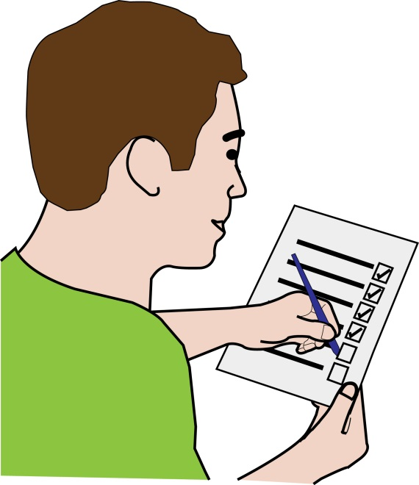
E-learning course
Training on the relevant sections of the Equality Act
Ss6, 13, 15, 19-21, 29
The aim of the course is to function as a guide to refer to on everyday disability discrimination issues
Examples and short quizzes throughout
End of course assessment

Slide 6
Precedent letters
We have complaint and Pre-Action Protocol letters and complaint letters
Issues include:
Unsuitable accommodation offered (s193)
Unsuitable accommodation offered (s188)
Unsuitable accommodation (B&B)
DWP failure to make reasonable adjustments
Failed assistance on trains
Train: refused boarding (mobility aids)
Taxi: refused boarding (mobility aids)
Housing disrepair
Refusal to provide disability-related equipment

Slide 7
To register for the course
Email: papadmin@dpglaw.co.uk

