Slide 1

Influencing through co-production
Shannon Johnstone, Policy and Research Manager
Chris Brill, Policy and Operations Director
Expert Link – Humanity, Honesty, Hope

Slide 2
About Expert Link
Engaging people with lived experience
Bringing together people with lived experience and decision makers
Success stories
Expert Link – Humanity, Honesty, Hope

Slide 3
We are a peer led organisation championing the voice of people with lived experience of multiple disadvantages, including homelessness, mental health issues, substance misuse, offending and domestic violence and abuse.
Expert Link – Humanity, Honesty, Hope

Slide 4
Our purpose is to inspire, support and champion co-production, with the voices of people with lived experience at our heart.
We believe in humanity and the potential of all people. When we come from a place of honesty, we can create the change that we want to see and bring hope into our world
Expert Link – Humanity, Honesty, Hope

Slide 5
Co-production is a strength-based process that equitably involves all stakeholders in the design and delivery of polices and services.
Expert Link – Humanity, Honesty, Hope

Slide 6
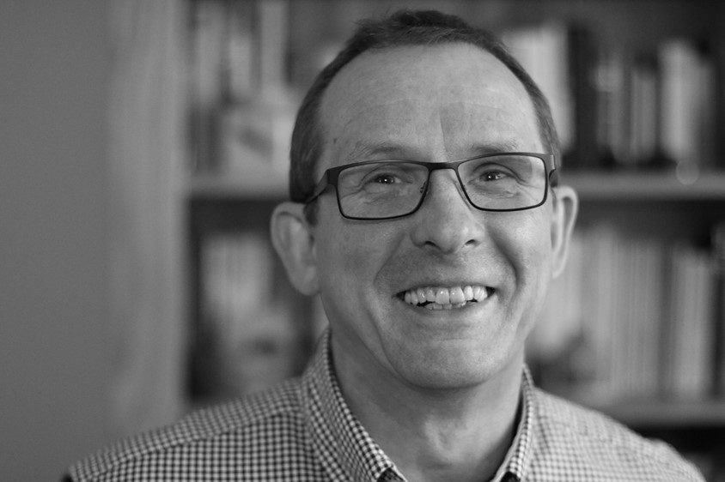

Slide 7
Engaging people with Lived Experience
Flexibility
Honesty
Value
Improvements
Expert Link – Humanity, Honesty, Hope

Slide 8
Benefits of Co-production
Connection
Change
Experience
Knowledge
Future
Expert Link – Humanity, Honesty, Hope

Slide 9
Success Stories
National Advisory Panel
Welfare Change Group
Peer Research
Expert Link – Humanity, Honesty, Hope

Slide 10
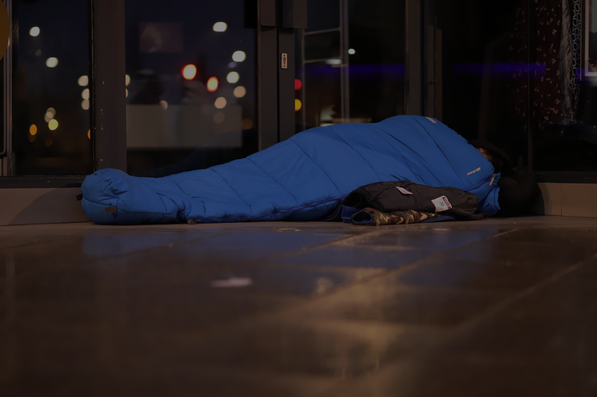
What was the National Advisory Panel (NAP)?
The NAP was a regular forum, set-up in April 2021 in response to the COVID-19 pandemic, as a way of ensuring that national Government heard the impact of pandemic from those with direct experience of disadvantage.
Membership was from across England. All members had lived experience of disadvantage and are passionate about giving people a voice in key decisions made about their lives.

Slide 11
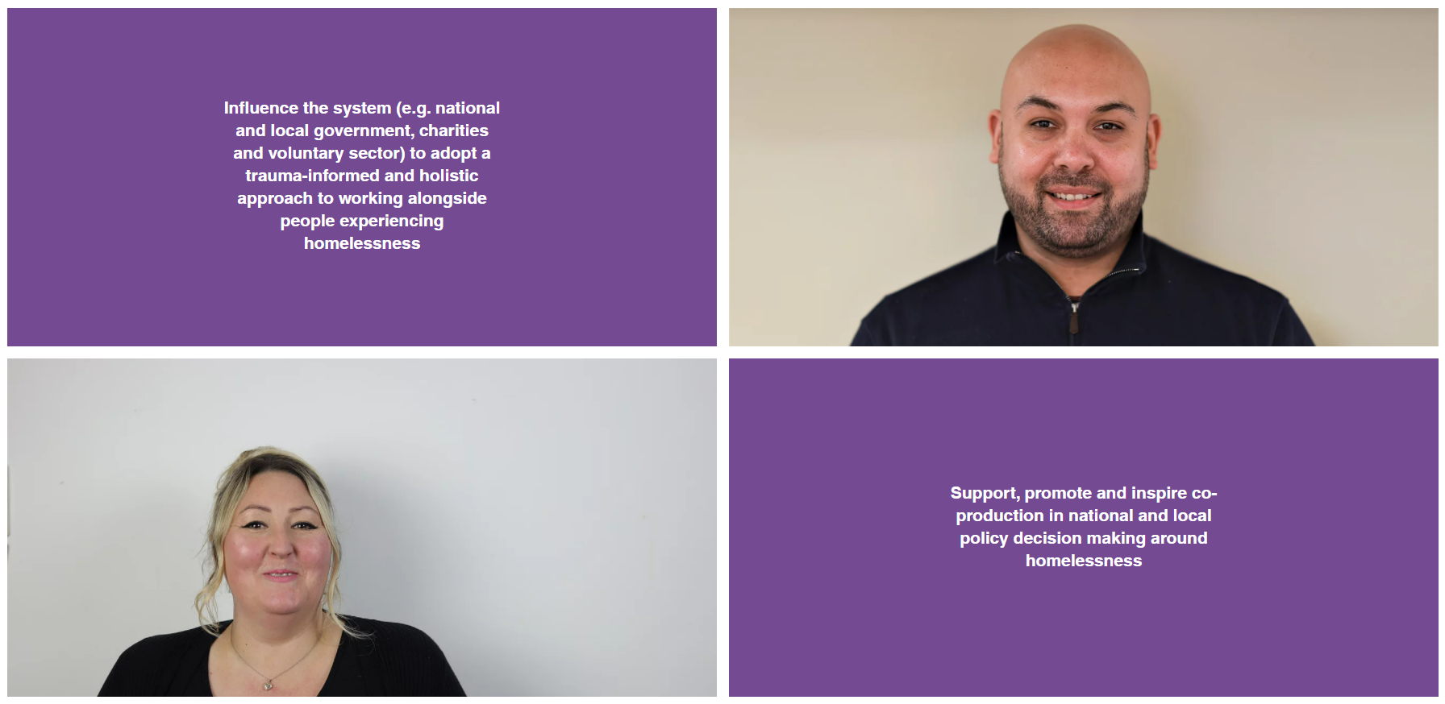
What were the aims of the NAP?

Slide 12
What evidence have we given to Government?
LOTS of reports to MHCLG, blogs and vlogs
HCLG Committee Inquiry: Impact of COVID-19 (Coronavirus) on homelessness and the private rented sector
Law Commission inquiry into Hate Crime
Independent review of drugs: part 2 ‒ prevention, treatment and recovery
Kerslake Commission on Rough Sleeping

Slide 13
Who has joined our meetings?
Jeremey Swain (Former MHCLG lead on Homelessness and Rough Sleeping)
Dame Carol Black (and team)
Matt Downie MBE (Director at CRISIS)
Jon Kuhrt (MHCLG Lead on Faith and Community Groups)
Jon White (MHCLG Lead on Street Counts)
Homeless Link and MIND staff (Strengths Based Practice)
Secretariat Kerslake Commission

Slide 14
Recommendations to Dame Carol Black
Recommendation 1: Train staff on the reasons those experiencing multiple disadvantages may have substance misuse difficulties
Recommendation 2: Employ and support people with lived experience of accessing drug and alcohol services throughout the workforce providing interventions.
Recommendation 3: Reduce reliance on outcomes measures and ensure staff meet a set of standards which will support recovery
Recommendation 4: Ensure all people experiencing multiple disadvantages receive housing as the basis of their support so they can realistically engage in treatment where they choose.
Recommendation 5: Increase the choice of support available which meets the needs and aspirations of the individual. This can build on some of the positive work during COVID-19 relating to rapid prescribing, phone call engagements and outreach work

Slide 15
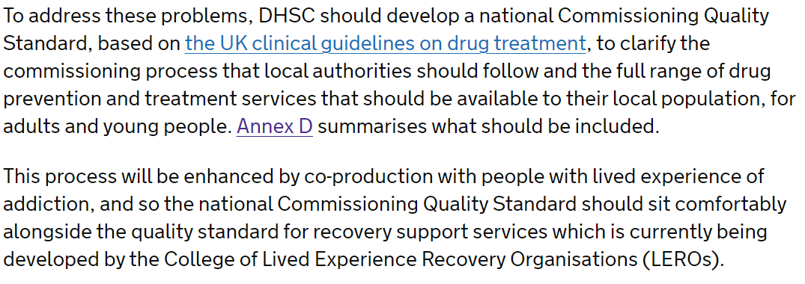
From Dame Carol Blacks Review – Co-production!
2.4 Review of drugs part two: prevention, treatment, and recovery - GOV.UK (www.gov.uk)

Slide 16
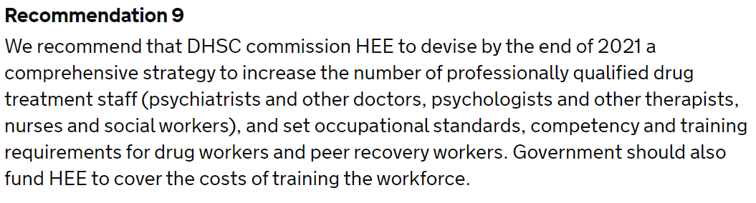
From Dame Carol Blacks Review – Staff training and standards!
3.1 Review of drugs part two: prevention, treatment, and recovery - GOV.UK (www.gov.uk)

Slide 17
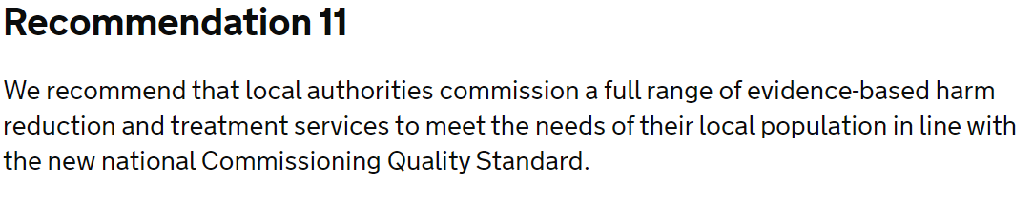
From Dame Carol Blacks Review – Increase the choice available
3.2 Review of drugs part two: prevention, treatment, and recovery - GOV.UK (www.gov.uk)

Slide 18
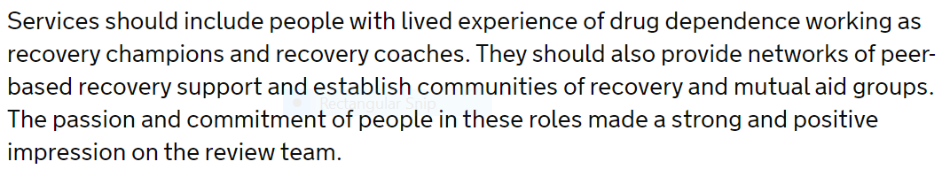
From Dame Carol Blacks Review – Employ people with lived experience!
3.4 Review of drugs part two: prevention, treatment, and recovery - GOV.UK (www.gov.uk)

Slide 19
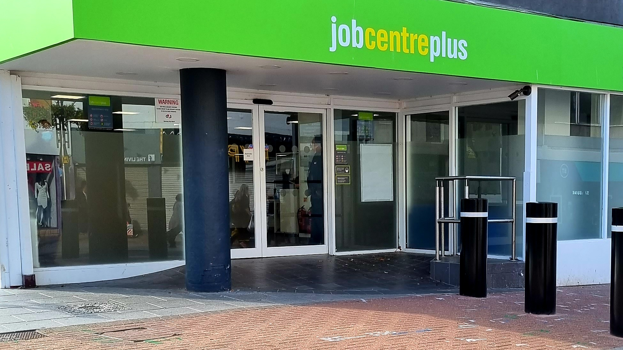
Working with the DWP
Meetings
Videos
Training
Peer mentors
Lloyds NEIF

Slide 20

Expert Link – Humanity, Honesty, Hope

Slide 21
Idea
Funding
Design of methods
Research questions
Fieldwork (interviews)
Analysis
Report
Sharing findings

Slide 22
If you want to find out more…
Visit www.expertlink.org.uk/
Or contact
Shannon Johnstone Shannon.Johnstone@expertlink.org.uk
Chris Brill
chris.brill@expertlink.org.uk
Expert Link – Humanity, Honesty, Hope

