Slide 1


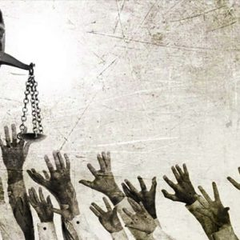
PLP Discrimination Conference 2024
Community Legal Strategies: Activating Rights through PLE & Partnerships
Emma Austin, Rights in Community Strategy Lead, CELC
Naomi Madden, Director of Projects, Grapevine
This Photo by Unknown Author is licensed under CC BY-SA-NC

Slide 2

Who We Are

Slide 3

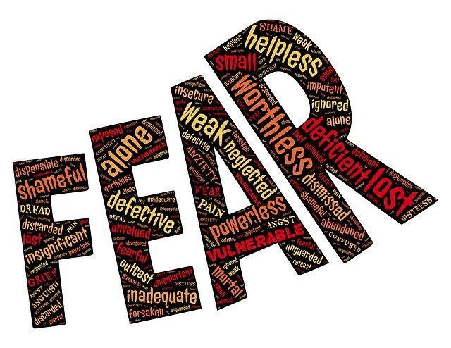



Barriers to Individuals Pursuing
and Enforcing Their Rights
This Photo by Unknown Author is licensed under CC BY
This Photo by Unknown Author is licensed under CC BY-SA
This Photo by Unknown Author is licensed under CC BY-SA-NC
This Photo by Unknown Author is licensed under CC BY
Notes:
LASPO, Advice deserts, Capacity of providers, Poor public authority decision-making, Lack of legal literacy
CELC’s approach to giving law back to community developed through delivery of varied projects aimed at helping us target legal advice and support to those who need it most
Outreach - Syrian Project, MiFriendly Cities, Kids in Need of Defence, PLE with organisations - Benefits Aware, the MAC (Mother and Child) Project, systems change within public authorities – Ignite, SPLC
EA to talk re one project in particular that considered on existing learning, built on, developed and then solidified our thinking on this.

Slide 4
Traditional Lawyering
Inaccessible – most marginalised often excluded due poor legal literacy, capability, confidence, costs(/perceived costs), Legal Aid deserts, limited capacity of practices etc.
Reactive – late identification of issues. Issues not addressed until point of crisis. Litigation focused.
Transactional and individualistic – those with same problems remain separate. Issues are siloed. Systemic underlying issues not always tackled. Broader questions not asked.
Imbalanced - lawyers seen as sole custodians of expertise. Exclusively capable of pursuing and enforcing rights and advocating for change.
Limited functional partnerships with community partners – referral sources.
Notes:
LASPO, Advice deserts, Capacity of providers, Poor public authority decision-making, Lack of legal literacy
CELC’s approach to giving law back to community developed through delivery of varied projects aimed at helping us target legal advice and support to those who need it most
Outreach - Syrian Project, MiFriendly Cities, Kids in Need of Defence, PLE with organisations - Benefits Aware, the MAC (Mother and Child) Project, systems change within public authorities – Ignite, SPLC
EA to talk re one project in particular that considered on existing learning, built on, developed and then solidified our thinking on this.

Slide 5
Traditional Lawyering v Barriers
Traditional lawyering often doesn’t combat barriers – access to justice not achieved through provision of advice alone.
This Photo by Unknown Author is licensed under CC BY
This Photo by Unknown Author is licensed under CC BY-SA
This Photo by Unknown Author is licensed under CC BY-SA-NC
This Photo by Unknown Author is licensed under CC BY
Notes:
LASPO, Advice deserts, Capacity of providers, Poor public authority decision-making, Lack of legal literacy
CELC’s approach to giving law back to community developed through delivery of varied projects aimed at helping us target legal advice and support to those who need it most
Outreach - Syrian Project, MiFriendly Cities, Kids in Need of Defence, PLE with organisations - Benefits Aware, the MAC (Mother and Child) Project, systems change within public authorities – Ignite, SPLC
EA to talk re one project in particular that considered on existing learning, built on, developed and then solidified our thinking on this.

Slide 6


Overcoming Barriers
Access to justice is achieved by putting law in the hands of those with rights - giving law back to community.
CELC’s approach developed over time through projects – targeted outreach work, targeted (and practical) public legal education, partnership-building, strategic policy influencing.
Rights in
Peril
Rights
in Peril
RIPPLE
Notes:
LASPO, Advice deserts, Capacity of providers, Poor public authority decision-making, Lack of legal literacy
CELC’s approach to giving law back to community developed through delivery of varied projects aimed at helping us target legal advice and support to those who need it most
Outreach - Syrian Project, MiFriendly Cities, Kids in Need of Defence, PLE with organisations - Benefits Aware, the MAC (Mother and Child) Project, systems change within public authorities – Ignite, SPLC
EA to talk re one project in particular that considered on existing learning, built on, developed and then solidified our thinking on this.

Slide 7
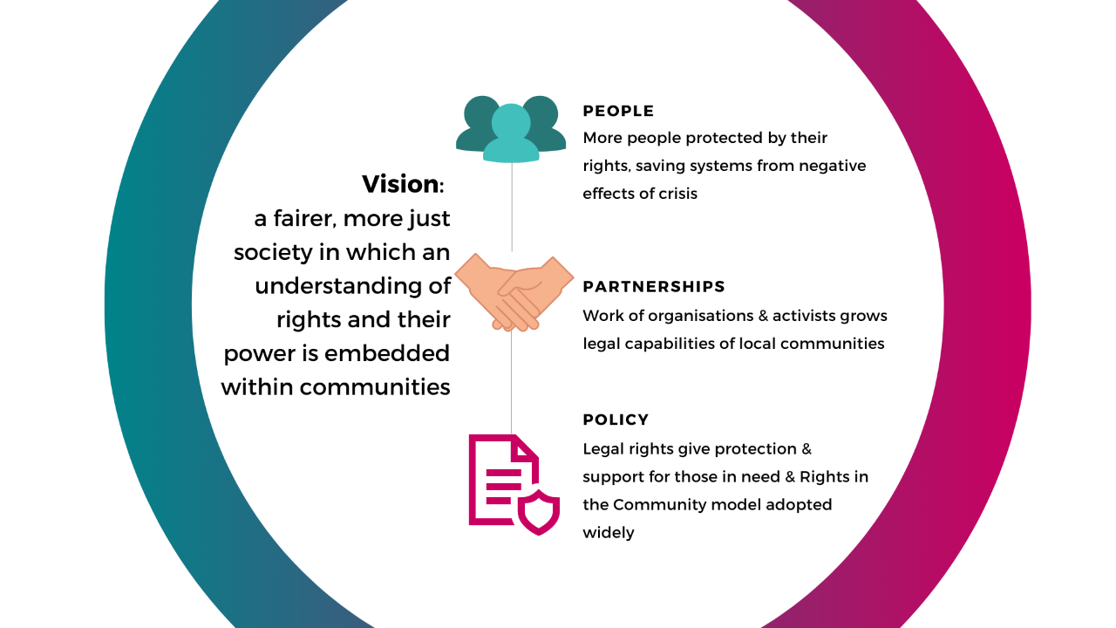
CELC’s Rights in Community Strategy
Notes:
Based on our learning – we’ve changed the way we work. We no longer want to be custodians of the law – gatekeepers of knowledge. Recognize the power imbalance between those who know the law and those who need its protection.
CELC developed a new strategy – Rights in Community – where we now seek to generate access to justice - by giving law back to community – in all our activities. Our new vision is to create….

Slide 8
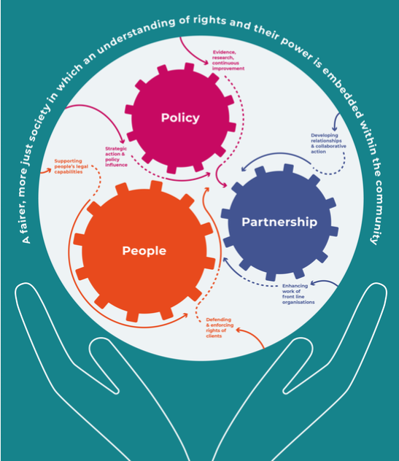

Slide 9
Key Features of the Strategy
Casework/strategic casework is powerful but is only part of the story.
Public Legal Education – people with legal rights need to know they have these. Instilling legal rights knowledge within communities and tools to use this knowledge.
Partnerships (people with lived-experience, third sector, frontline organisations, statutory bodies) essential to (i) help lawyers understand real problems individuals face (ii) spread knowledge of legal rights, (iii) enable people to use their rights (earlier/at all), (iv) connect people, (v) help influence law and policy.
Notes:
LASPO, Advice deserts, Capacity of providers, Poor public authority decision-making, Lack of legal literacy
CELC’s approach to giving law back to community developed through delivery of varied projects aimed at helping us target legal advice and support to those who need it most
Outreach - Syrian Project, MiFriendly Cities, Kids in Need of Defence, PLE with organisations - Benefits Aware, the MAC (Mother and Child) Project, systems change within public authorities – Ignite, SPLC
EA to talk re one project in particular that considered on existing learning, built on, developed and then solidified our thinking on this.

Slide 10
PLE and Partnerships in Action
- CELC and Grapevine
Mutual Respect and aligned values.
Listening to partner about emerging problems/patterns. Respecting knowledge, skill and expertise.
Increasing rights awareness – through targeted programmes of work, training, shared resources, toolkits, crib sheets etc.
Legal capability-building of partner – through second-tier support and advice.
Ongoing legal rights embedding work to support partner to improve response to presenting problems to reflect role of rights, take early actions to activate/enforce rights to avoid “avalanche of issues”, preventative work and identify boundaries where specialist input needed.
Bringing wider partners together around issues of shared concern to develop coordinated responses, pool resources and maximise impact (e.g. Poverty Alliance).
Notes:
LASPO, Advice deserts, Capacity of providers, Poor public authority decision-making, Lack of legal literacy
CELC’s approach to giving law back to community developed through delivery of varied projects aimed at helping us target legal advice and support to those who need it most
Outreach - Syrian Project, MiFriendly Cities, Kids in Need of Defence, PLE with organisations - Benefits Aware, the MAC (Mother and Child) Project, systems change within public authorities – Ignite, SPLC
EA to talk re one project in particular that considered on existing learning, built on, developed and then solidified our thinking on this.

Slide 11
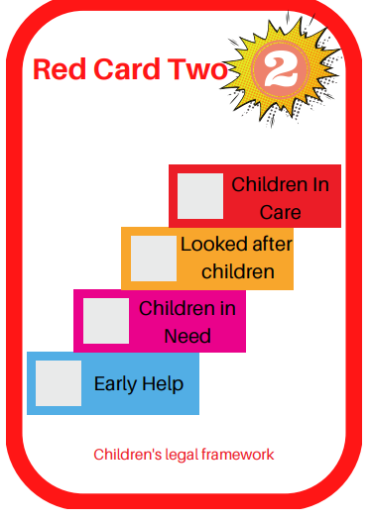
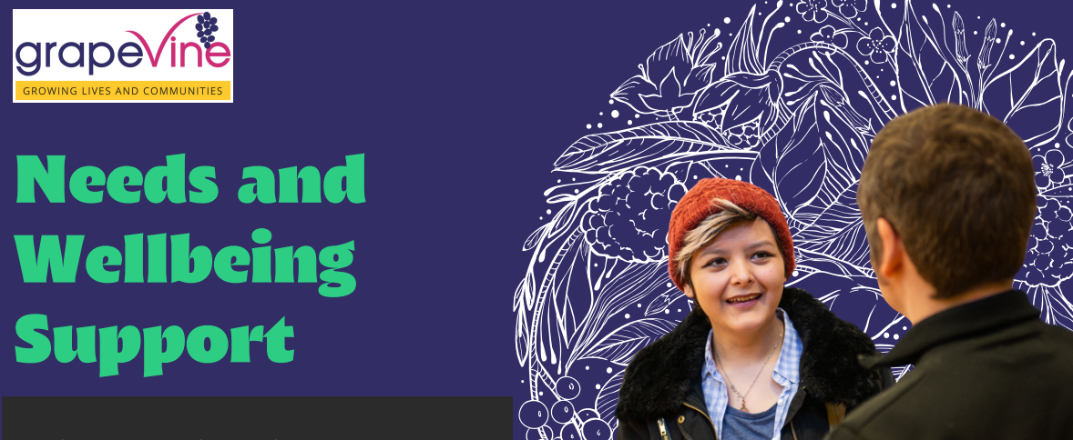

Examples of Rights Resources
- How Grapevine Use These
Rights Cards
Care Act Assessment Support
Annual Health Check Up Information
Financial Independence film
https://www.youtube.com/watch?v=tp9Xb8IwjAU
Notes:
LASPO, Advice deserts, Capacity of providers, Poor public authority decision-making, Lack of legal literacy
CELC’s approach to giving law back to community developed through delivery of varied projects aimed at helping us target legal advice and support to those who need it most
Outreach - Syrian Project, MiFriendly Cities, Kids in Need of Defence, PLE with organisations - Benefits Aware, the MAC (Mother and Child) Project, systems change within public authorities – Ignite, SPLC
EA to talk re one project in particular that considered on existing learning, built on, developed and then solidified our thinking on this.

Slide 12
Impact
How are approaches / practices at Grapevine improved by partnership work with CELC?
What difference does being a rights-informed /rights-based organisation make to the people Grapevine support?
What advice would Grapevine give to other community organisations about supporting people to use legal rights?
Notes:
LASPO, Advice deserts, Capacity of providers, Poor public authority decision-making, Lack of legal literacy
CELC’s approach to giving law back to community developed through delivery of varied projects aimed at helping us target legal advice and support to those who need it most
Outreach - Syrian Project, MiFriendly Cities, Kids in Need of Defence, PLE with organisations - Benefits Aware, the MAC (Mother and Child) Project, systems change within public authorities – Ignite, SPLC
EA to talk re one project in particular that considered on existing learning, built on, developed and then solidified our thinking on this.

Slide 13

Do you have any questions?

