Slide 1

Care Act Support for Migrants and Asylum Seekers
Brian Dikoff
Legal Organiser, Migrants Organise
April 2022

Slide 2





Who are we?
Community Programme
Community Organising and Campaigns
MMCA Project
Legal Aid Crisis

Slide 3
What is the Care Act 2014?
Places a duty on councils to support and promote the wellbeing and independence of working age disabled adults and older people, and their unpaid carers and gives them more control of their care and support.
Not about health conditions or disabilities per se: rather about day to day ”needs” or “outcomes”
  Manging and maintaining nutrition
  Maintaining personal hygiene
  Managing toilet needs
  Being appropriately clothed
  Being able to make use of the home safely
  Maintaining habitable home environment
  Developing or maintaining family or other personal relationships
  Accessing or engaging in work, training, education or volunteering
  Making use of facilities and services, including public transport
  Caring responsibilities

Slide 4
What can people obtain from Care Act?
Local authority has duty to assess whether a person has needs for care and support (s9 Care Act 2014)
If eligible care needs, local authority required by s18 to meet that need as long as person ‘ordinarily resident’ and meets financial criteria. Required by s20 to meet a carer’s needs.
  Care and support plan needs to be developed together with the person
  If the needs are “accommodation related”, then social services need to provide the accommodation, NOT NASS (see R (Westminster City Council) v NASS [2002] UKHL, and R(TMX) v Croydon_
If not eligible, then they still need to provide advice, in theory, to promote independence and welfare

Slide 5
Who can obtain Care Act?
Individuals with NRPF
Provided that they pass
The Human Rights Assessment
Asylum Sekeers
i.e. not providing care and support will breach their human rights because they cannot be expected to leave the country to fulfil their needs. E.g. if they have a pending HR claim. KA v Essex County Council [2013] EWHC 43, the Court found that an ongoing procedural right to pursue a human rights claim from within the UK must be treated as a legal barrier to return.

Slide 6
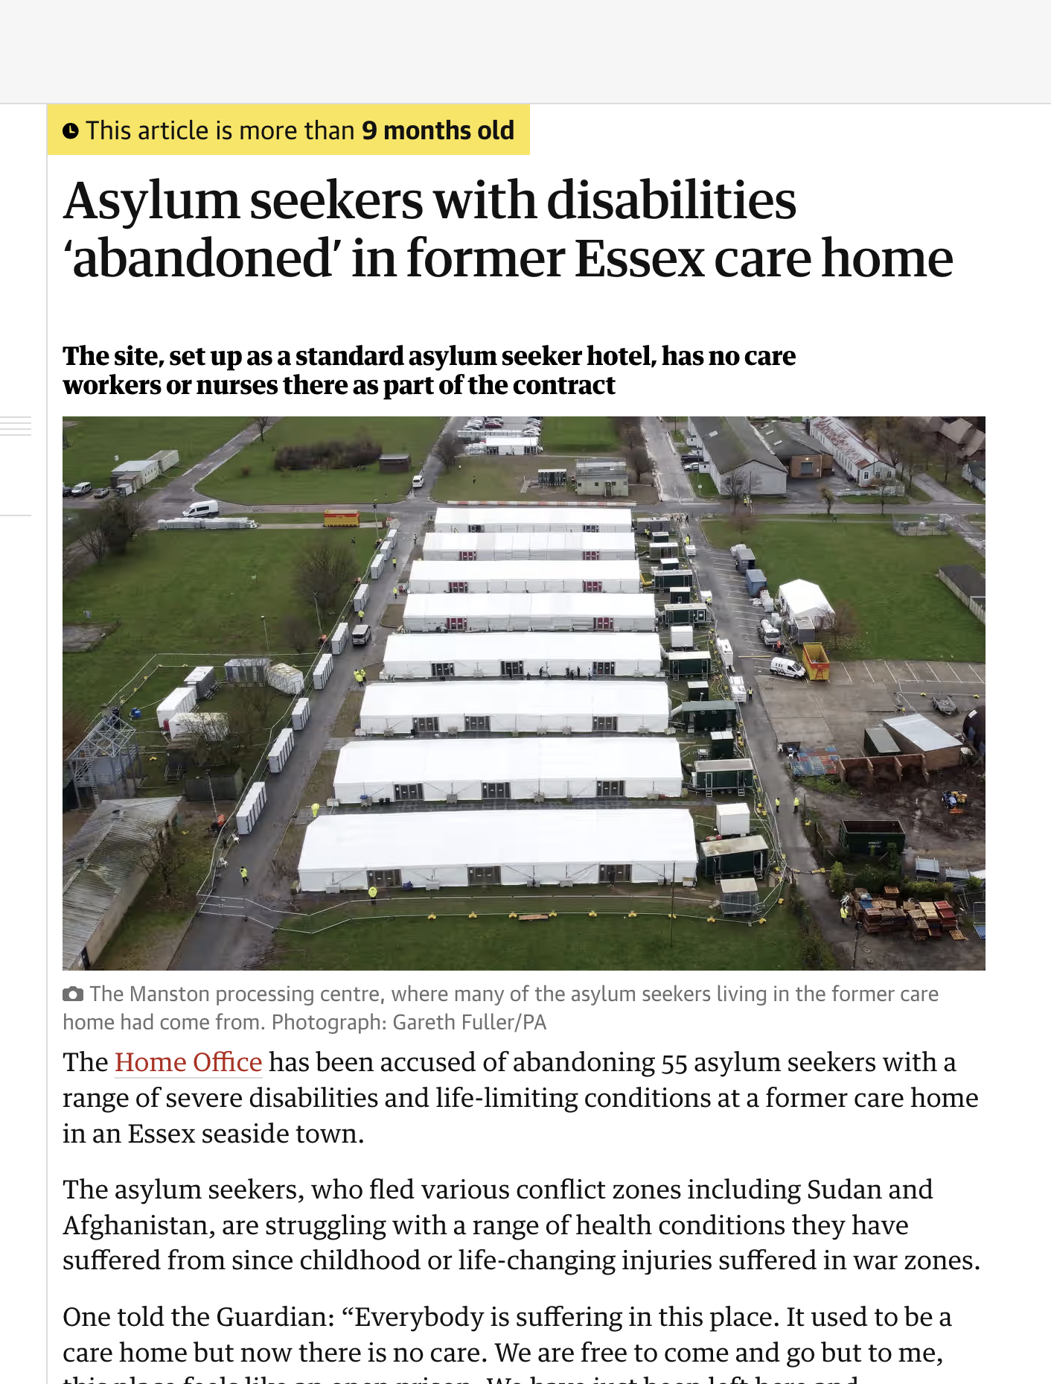
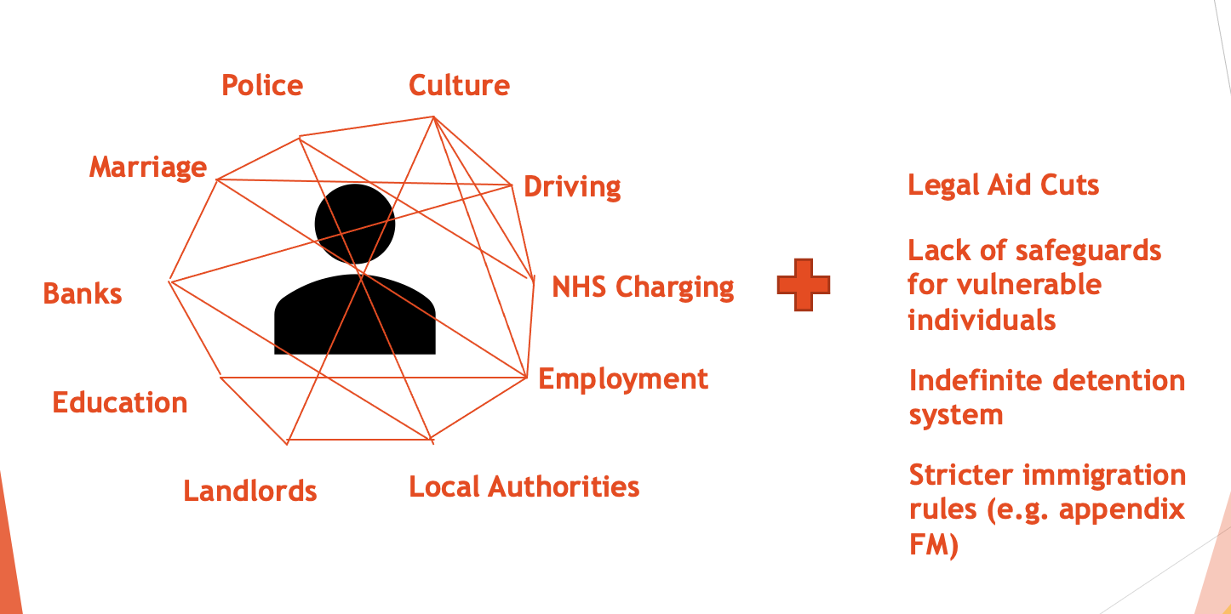
Problem?

Slide 7
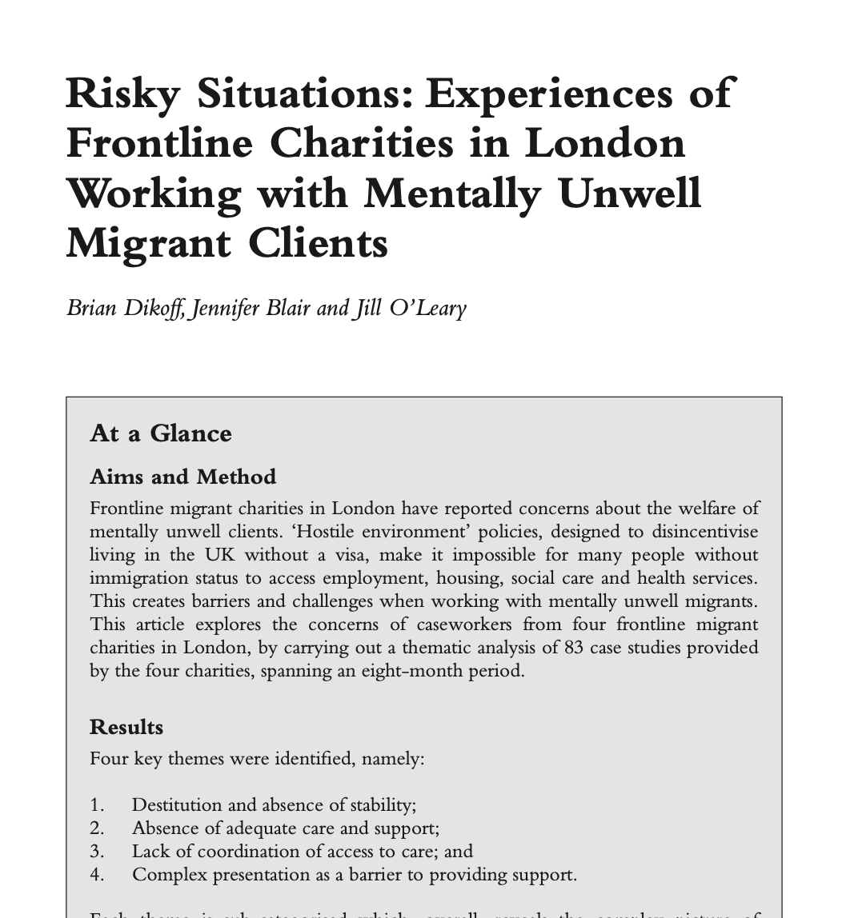

Slide 8
Woman suffering from severe depression, suicidality and symptoms of psychosis who experienced frequent dissociation. Because she was sofa-surfing between different addresses no local authority would accept she lived in their area for an assessment under the Care Act 2014 (Care Act).
The result of this gate-keeping is that the charity would be left responsible for trying to safeguard a vulnerable person, who they had assessed as requiring more intensive care than they were able to provide. An overly-legalistic approach to Care Act assessment, whereby designated NRPF teams would conduct a complicated ‘human rights assessment’ or a legal aid lawyer would be needed to even obtain a needs assessment was consistently identified.
Social workers and NRPF teams were not seen as perceiving themselves as agents for protecting the human rights of vulnerable migrants, particularly adults. In 13 of the case studies the charity had to refer the client to a solicitor to prevent homelessness. Litigation seemed to routinely be required to obtain support from social services teams, with unrepresented vulnerable adults being turned away from support otherwise.
One example was for a 70-year-old disabled woman where the charity sent detailed medical evidence to the social services department to support a Care Act assessment. Despite being followed up, this referral was not acted on for three months and in that time the woman’s health deteriorated due to unsuitable living conditions and she was hospitalised. Eventually the local authority undertook the assessment by a duty social worker calling the woman for 20 minutes. They refused to speak to the caseworker who had made the referral and issued a decision that the woman did not have eligible care needs.

Slide 9
Why?
Hostile Environment
Lack of awareness amongst statutory services
Very high cost for social services to support yet no coordination with the Home Office
  .e.g. in one case, SAR states that it’s costing LA £100k per year – yet no action from HO to resolve the case. Someone who has been under MH section / mental health support since 2001
  Similar situation in ECPAT v Kent City Council `
Lack of awareness of the care act process amongst individuals and groups (?) – yet another area of law to think about!
Cases referred are not front loaded – Care Act can only be challenged via Judicial Review. In brief; you have to show ”unreasonableness” on behalf of the social worker. Very high bar

Slide 10
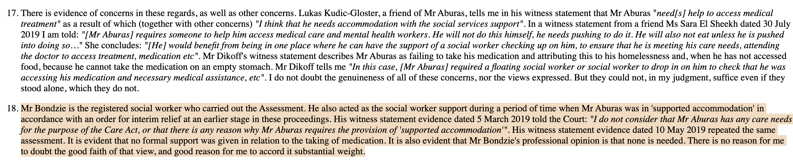
Aburas v Southwark

Slide 11
How to support someone?
Examples, examples, examples!
  Remember that Care Act is not about health conditions or disabilities
  Go back to the outcomes, address it one by one – why do you think the person struggles to “eat or cook”?
  Note it as much as possible – e.g. diary
Duty to assess is very low – “appears to have care needs” → refusal to assess very likely is unlawful
Get charities and legal aid solicitors to be involved: e.g. Wilsons, DPG, Gold Jennings, Public Law Project,

Slide 12
Thank you and get in touch!
Brian@migrantsorganise.org

