Slide 1
Funding for impact: view from the Nuffield Foundation
Rob Street, Nuffield Foundation
Legal research for social impact conference, University of York, 17th May 2023

Slide 2

About the Nuffield Foundation
Our mission is to advance social well-being in a just and inclusive society.
We fund research with the capacity to make a difference to people’s lives by influencing UK policy and practice.
We fund research on all four UK nations.
Notes:
F

Slide 3
Freedom and independence
Rigour and quality
Our principles
Connecting perspectives
Building trust in evidence

Slide 4



Our core areas
Education
Welfare
Justice

Slide 5
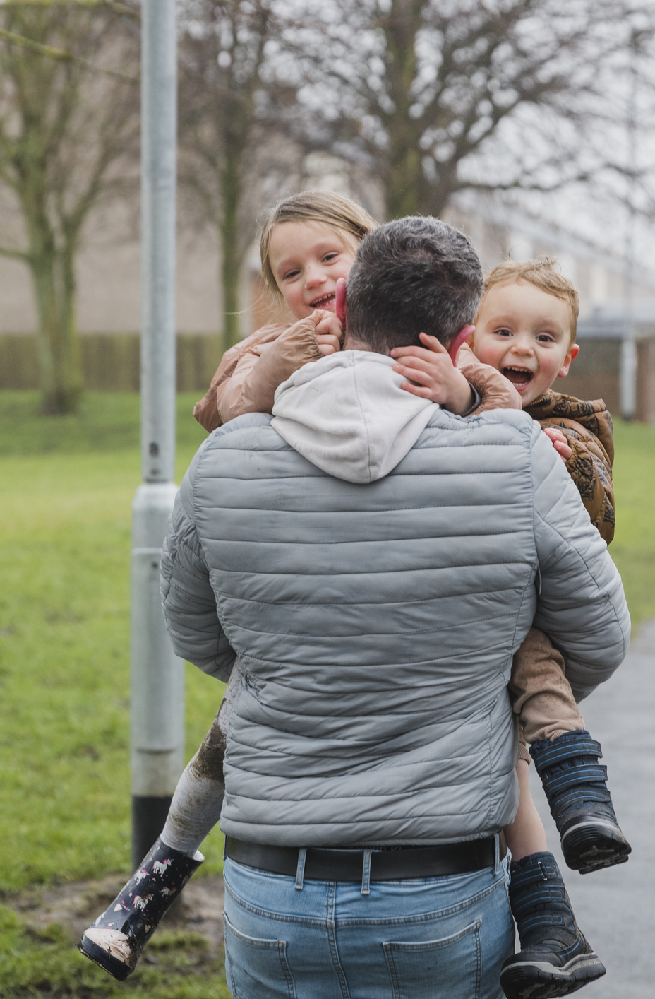
Society needs a fair and effective justice system
Critical challenges facing justice
Experiences and outcomes of justice system contact, incl impact on wider life chances
Broad view of justice and diverse research approaches encouraged
Notes:
T

Slide 6
Key themes and topics in Justice
Family justice
Social welfare
Youth justice
Access | Fair decisions | Outcomes | Trust | Systems

Slide 7
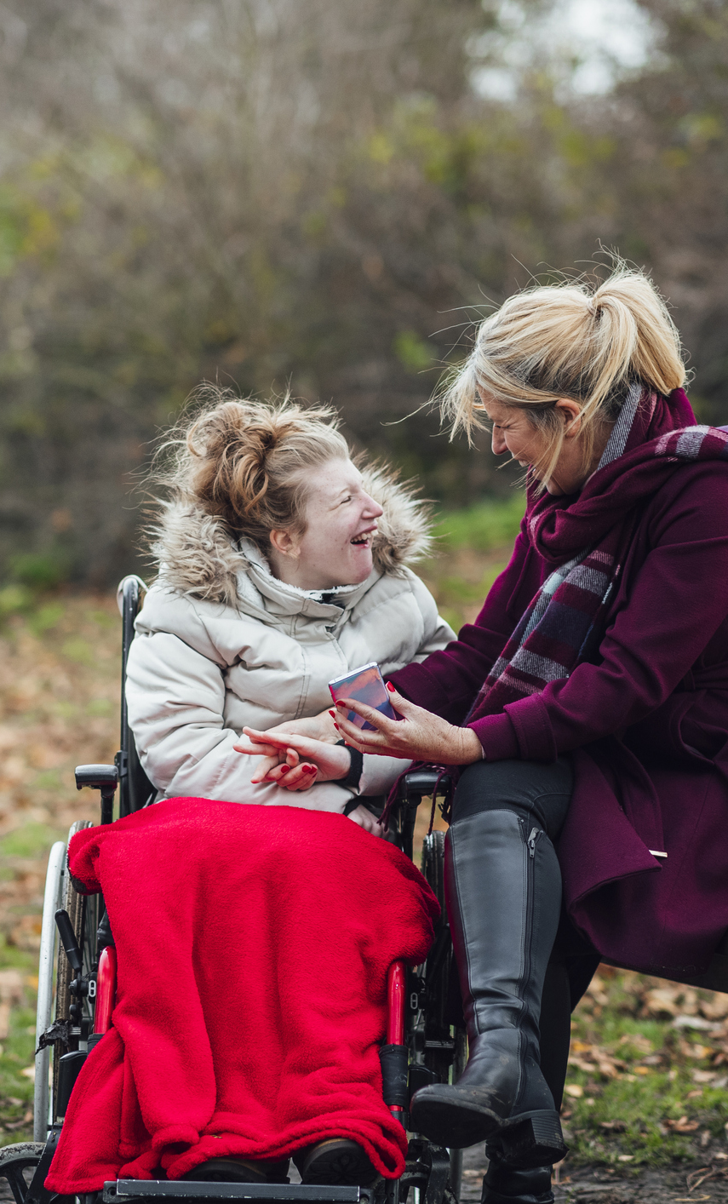

Grant-making snapshot
194 active grants
Total value of £59m
We award grants from £10k - £3m Most are £200k-£300k
Most grants run for 2 to 3 years

Slide 8
Research, Development and Analysis Fund
Two application rounds a year
Two stage application process:
Outline applications assessed in-house
Full applications peer reviewed
Final decisions are made by Nuffield Foundation staff and Trustees.
Most grants are between £200k - £300k.
September
Grants up to £750k
March
Grants up to £3m*
(*kept under review)

Slide 9
What we look for in applications
Relevance
Clear conceptual framework
Rigorous methodology
Great team
Value for money
Route to impact

Slide 10
Impact – what we mean
Routes to impact
Influencing policy or practice
Shaping debates
Capacity building
Positive change that contributes to our mission to improve social well-being
Can take different forms – and can take time and depend on external factors
Academic impact often features but is rarely enough on its own for funding

Slide 11
Impact – what we want
Clarity
Why is this research needed? Why now? What will it achieve?
Credibility
Rigorous and appropriate methodology
Planning
Routes to potential impact
Engagement
Who must do what for impact to happen?

Slide 12
Pensions on divorce (Hillary Woodward)
Free guides for practitioners and divorcing couples to help fair sharing of pensions
Helping Litigants in Person (Grainne McKeever)
Support for LIPs in NI: reference group to advise; new website resources; training for judiciary
Impact examples from Nuffield-funded projects
Impact examples from Nuffield funded projects
Non-legally binding weddings (Rajnaara Akhtar)
Informed the Law Commission’s recommendations for weddings law reform
Recurrent care proceedings (Karen Broadhurst)
Prompted new prevention progs for and better awareness of vulnerable mothers

Slide 13
Areas of development
Encouraging diverse applications
Effectively communicating our interests and funding opportunities
Supporting Early Career Researchers
New five-year strategy

Slide 14
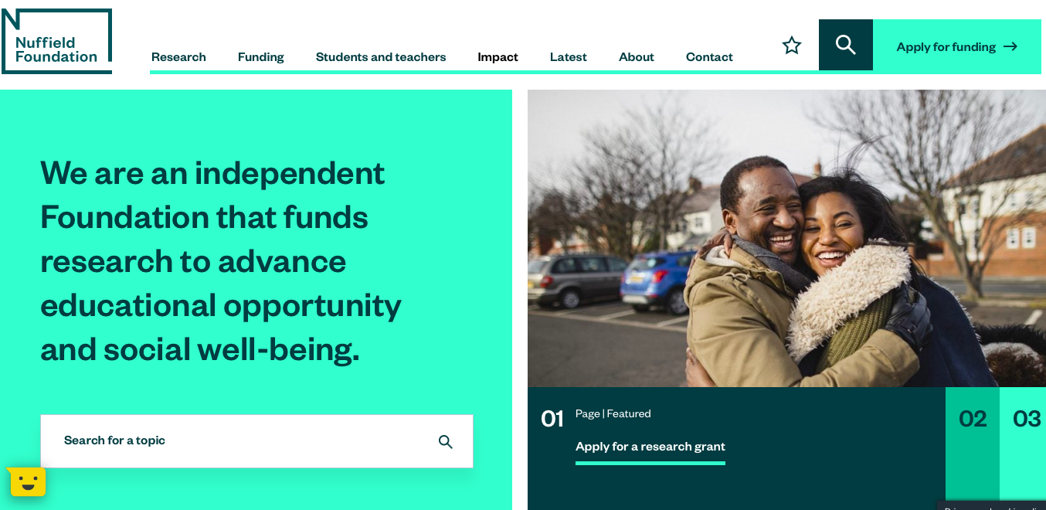
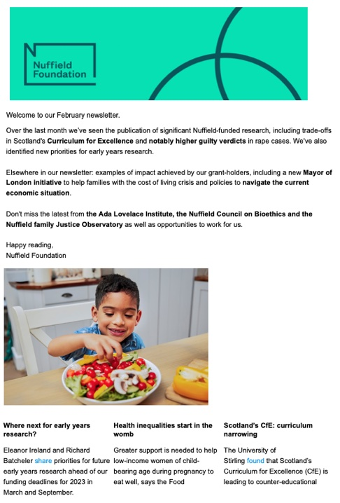



Keep in touch
Website: www.nuffieldfoundation.org
Twitter: @NuffieldFound
LinkedIn and YouTube
Subscribe to our newsletter
rstreet@nuffieldfoundation.org

