Slide 1
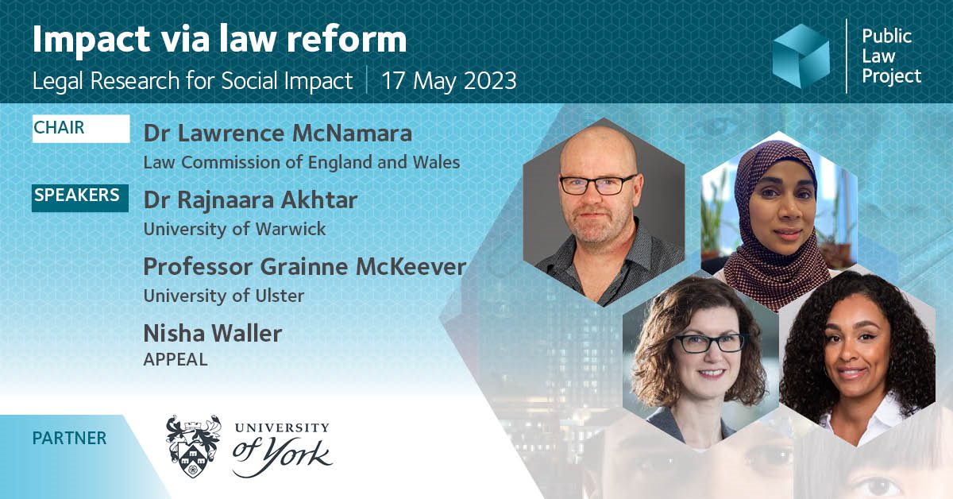

Slide 2


Non-legally Binding Ceremonies: Weddings Law Reform in England and Wales
Dr Rajnaara Akhtar

Slide 3
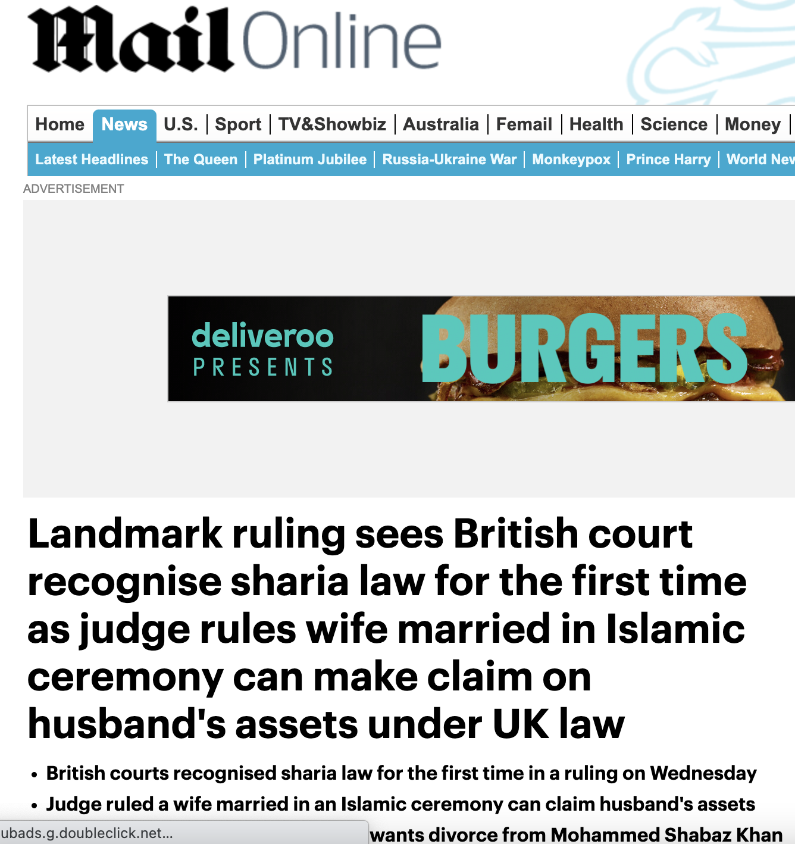

Slide 4

Overview of Research
Many couples have non-legally binding weddings to reflect faith or belief
Many such ceremonies' are not legally recognized
These ceremonies reflect the growing plurality in our society (England and Wales)
Policy attention disproportionately focused on Muslim couples
Outcomes
No recognition of marriage by the state for family law purposes
No family law remedies if the relationship breaks down/ one partner dies
No automatic notion of shared assets
No security for the economically weaker party (children, and often the woman)

Slide 5
Types of dual ceremonies
Civil & Nikah ​
Civil & Humanist​
Civil & Independent
Civil & Pagan ​
Civil & Interfaith
Civil & Hindu
Civil & Christian
Civil & Sikh
Civil & Baha'i
Christian & Hindu
Christian & Jewish
Christian & Nikah
Civil & Nikah & Christian
Civil & Zoroastrian & Christian
Civil & Jain
Christian & Christian

Slide 6
Advisory Group
Stakeholders
The Law Commission
Anne Barber (Director, Civil Ceremonies UK)
Teddy Prout (Director of Community Services, Humanists UK)
Nazia Rashed (Muslim Council of Britain; family law solicitor and mediator, Anthony Gold)
Siddique Patel (Deputy Director ROM; Partner, Gunnercooke LLP),
Professor Nawal Prinja (Vishwa Hindu Parishad)
Individuals
Frank Cranmer (Honorary Research Fellow at the Centre for Law & Religion at Cardiff)
Professor Liz Trinder (University of Exeter)
Dr Islam Uddin (imam and academic researcher)
Policy Makers
The Ministry of Justice

Slide 7
Impacting Policy
Stakeholders and policy makers
Advisory groups
Private meetings
Briefing notes
Grassroots
Those impacted by the issue
A change in narrative through blogs, seminars, community events, other outputs
Gatekeepers

Slide 8
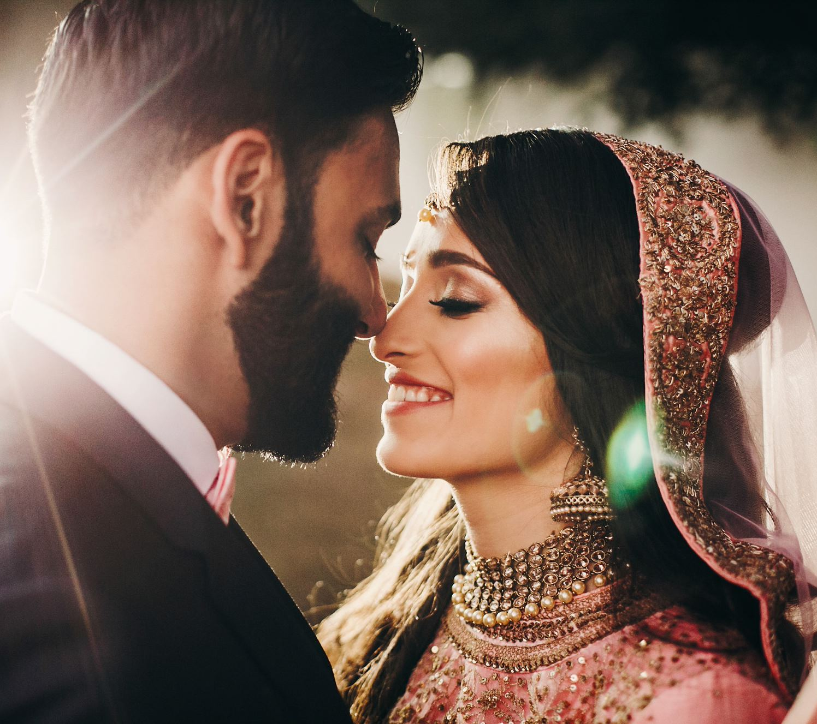
Why Muslim couples have NLB (nikah) ceremonies
More important than legal wedding
‘It’s the only valid form of ceremony in terms of my religion’
‘I could have had a civil ceremony but that doesn’t mean I’m married in our terms, as a Muslim. You’re only married once you’ve had the nikah..’
Necessary to enable relationship
‘no intimate relationship. Only through marriage.’
‘we’ve known each other a long time so we were extremely close in terms of the emotional aspect of things but physical intimacy, yeah, it would have had to have been marriage before.’

Slide 9

Reason for delaying or omitting a legal wedding
Delay
Legal or administrative barrier
Delay in getting round to it, ‘life’ getting in the way
Deliberate delay – to test the relationship
Omit
Financial considerations
Unable to access legal wedding
No desire to legally marry

Slide 10

Knowledge
Differing views as to levels of awareness across Muslim communities about the status of the nikah
‘so much awareness about it’
‘Even educated women… Their families told them, “This is all you need to do.” And then, you know, ten, 15, 20 years down the line, they find themselves in a very difficult position

Slide 11
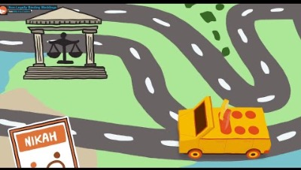

Slide 12
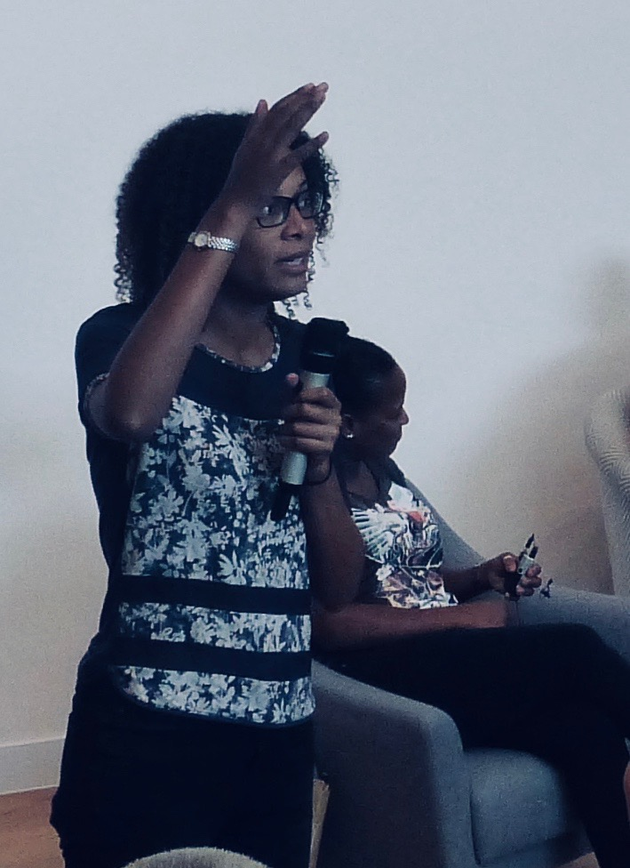
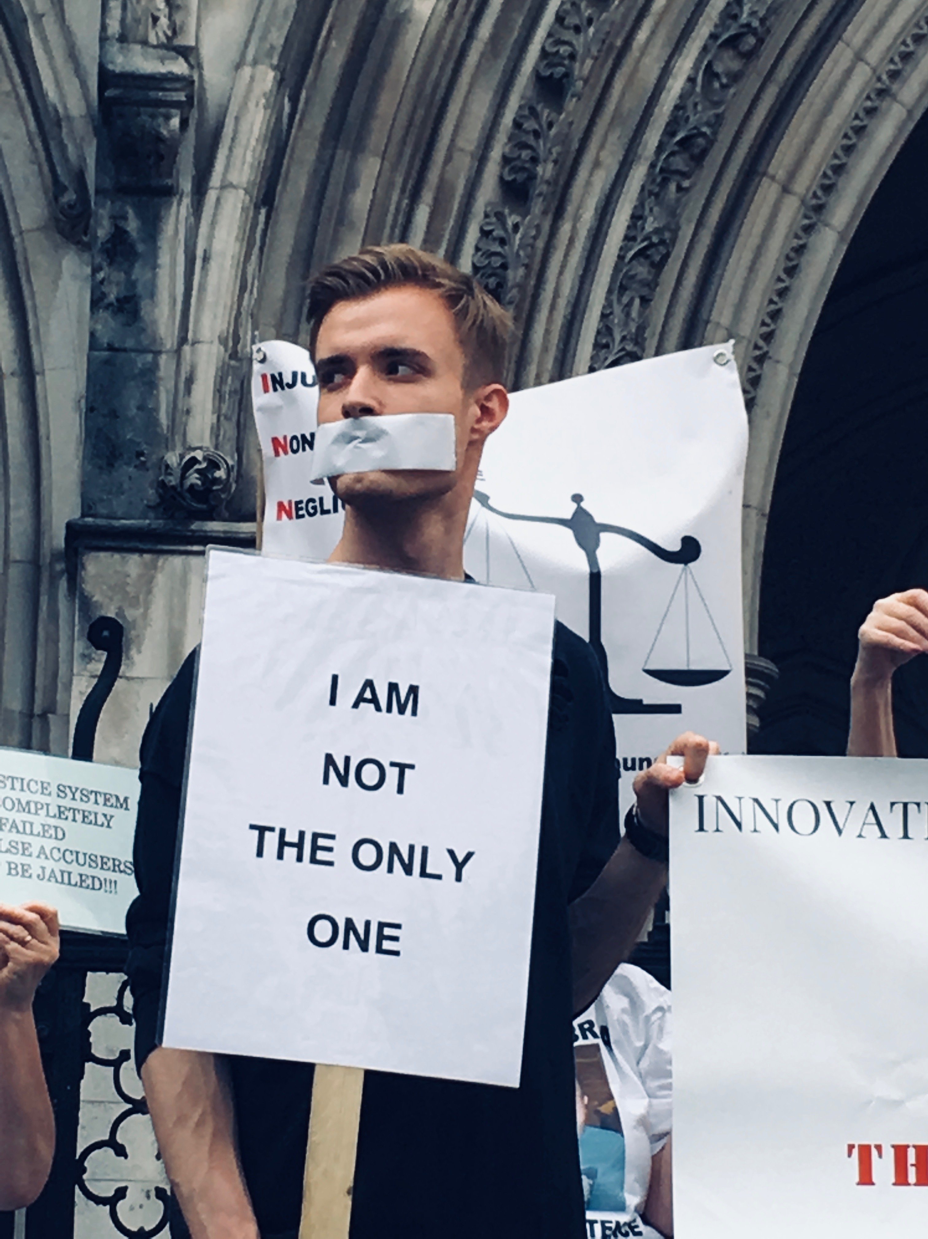
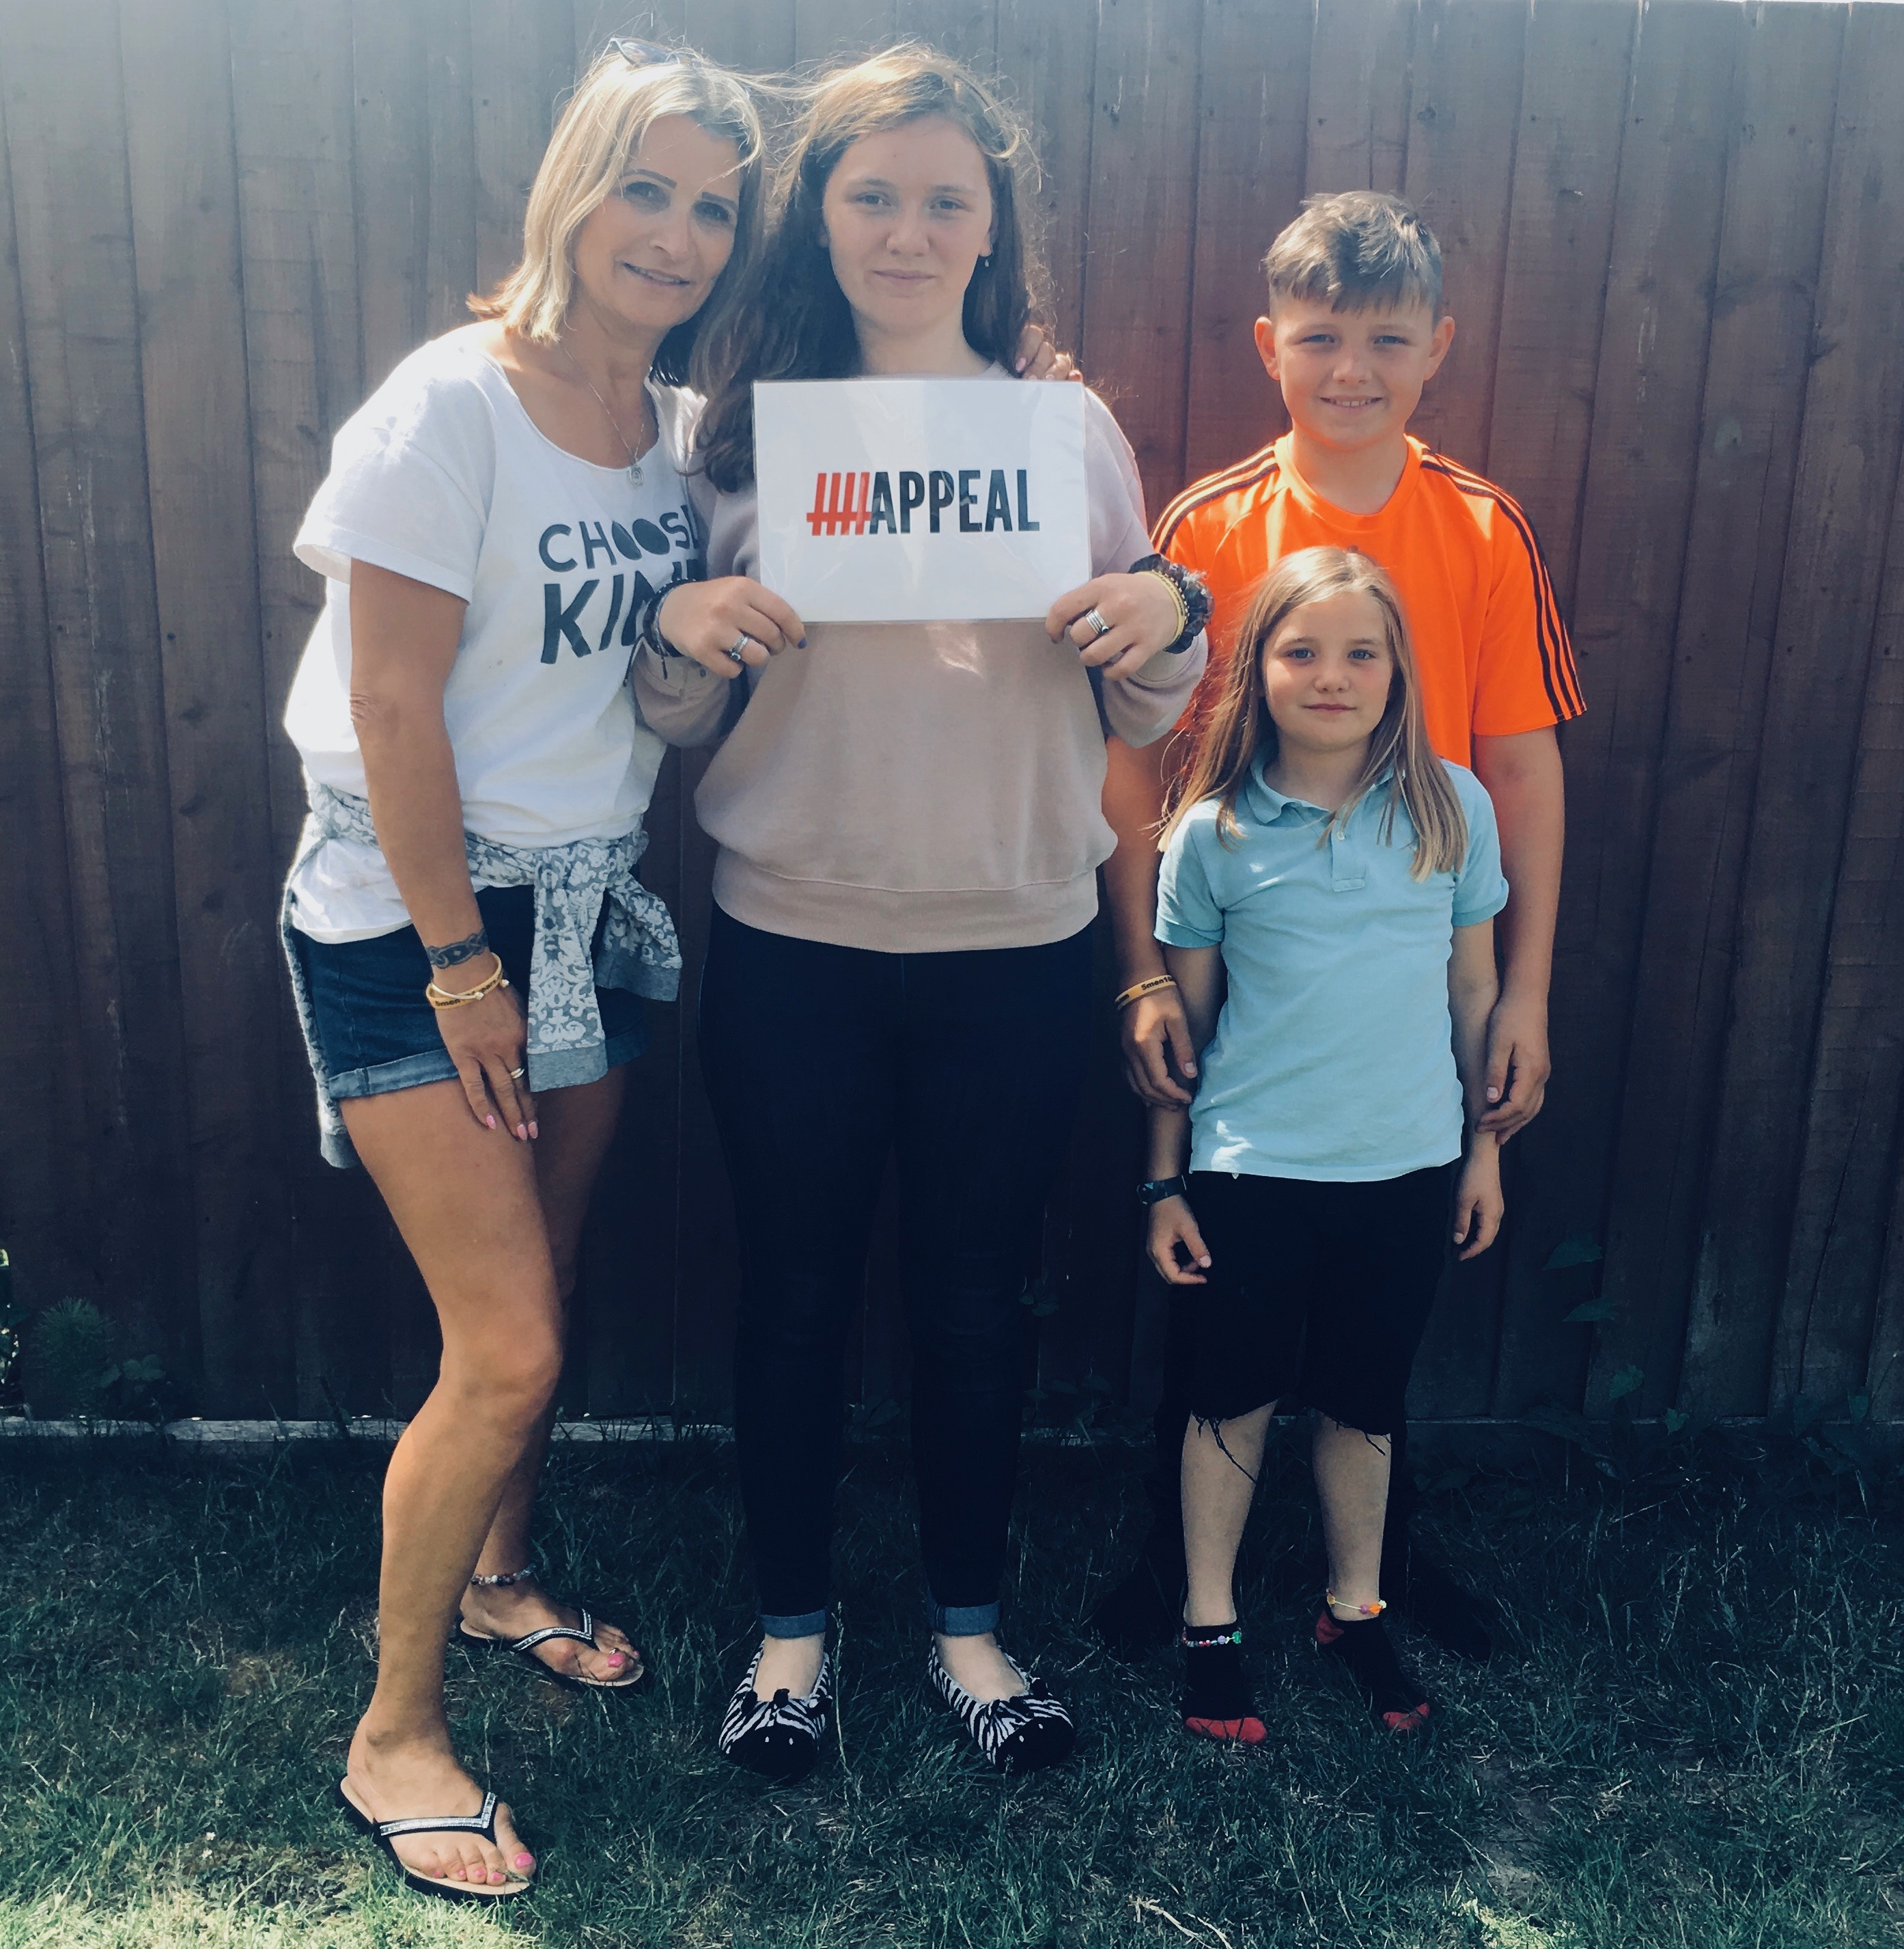
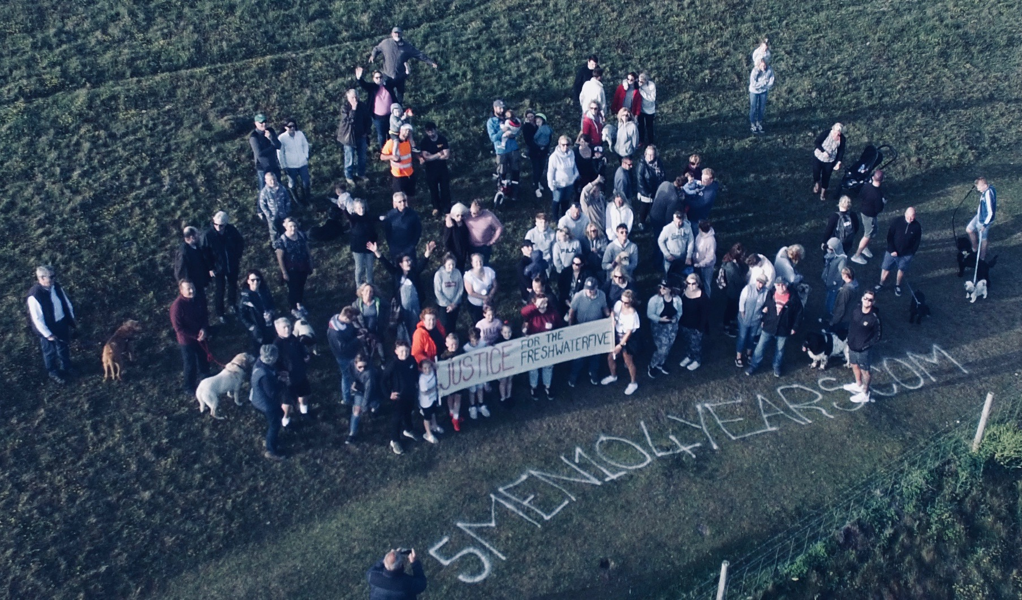
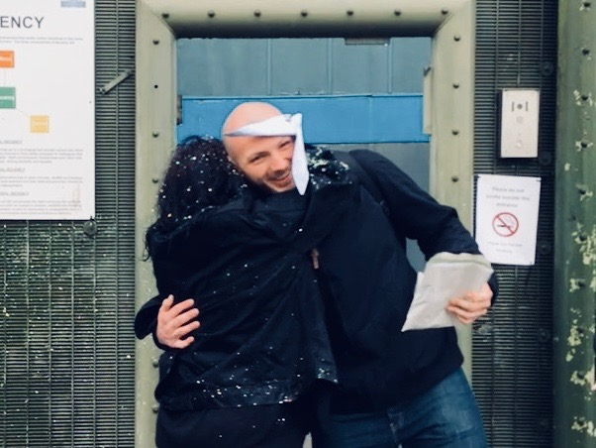
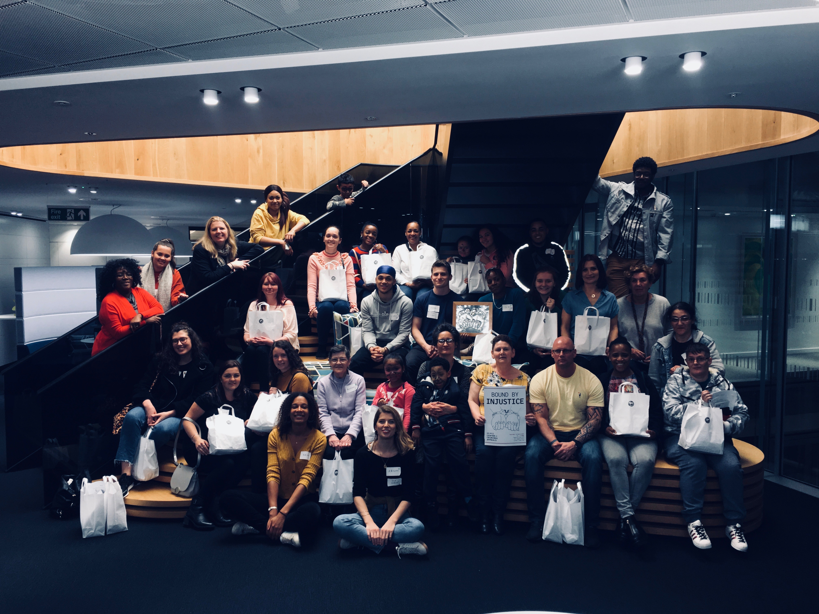
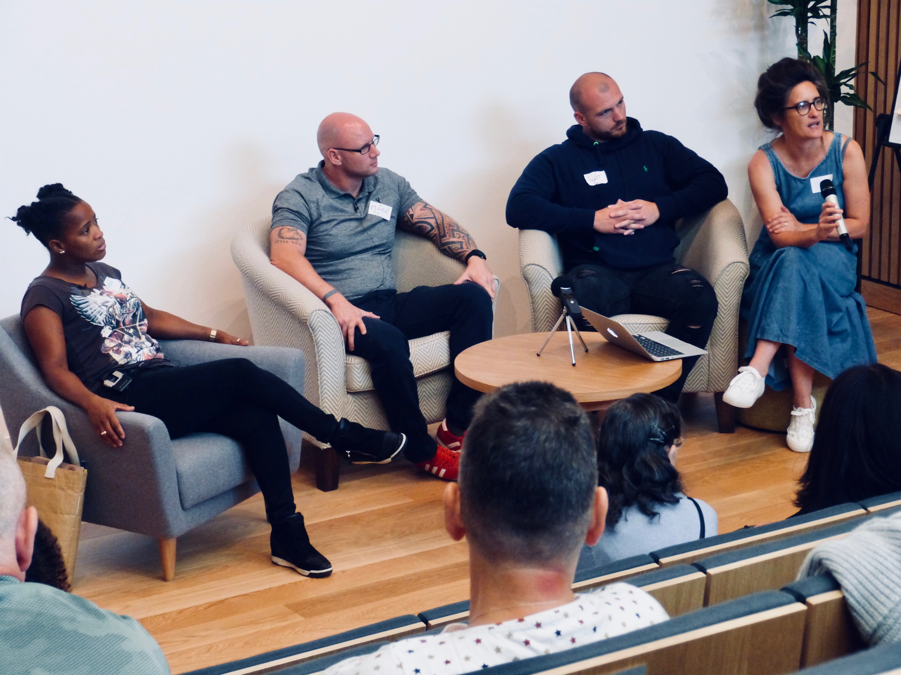
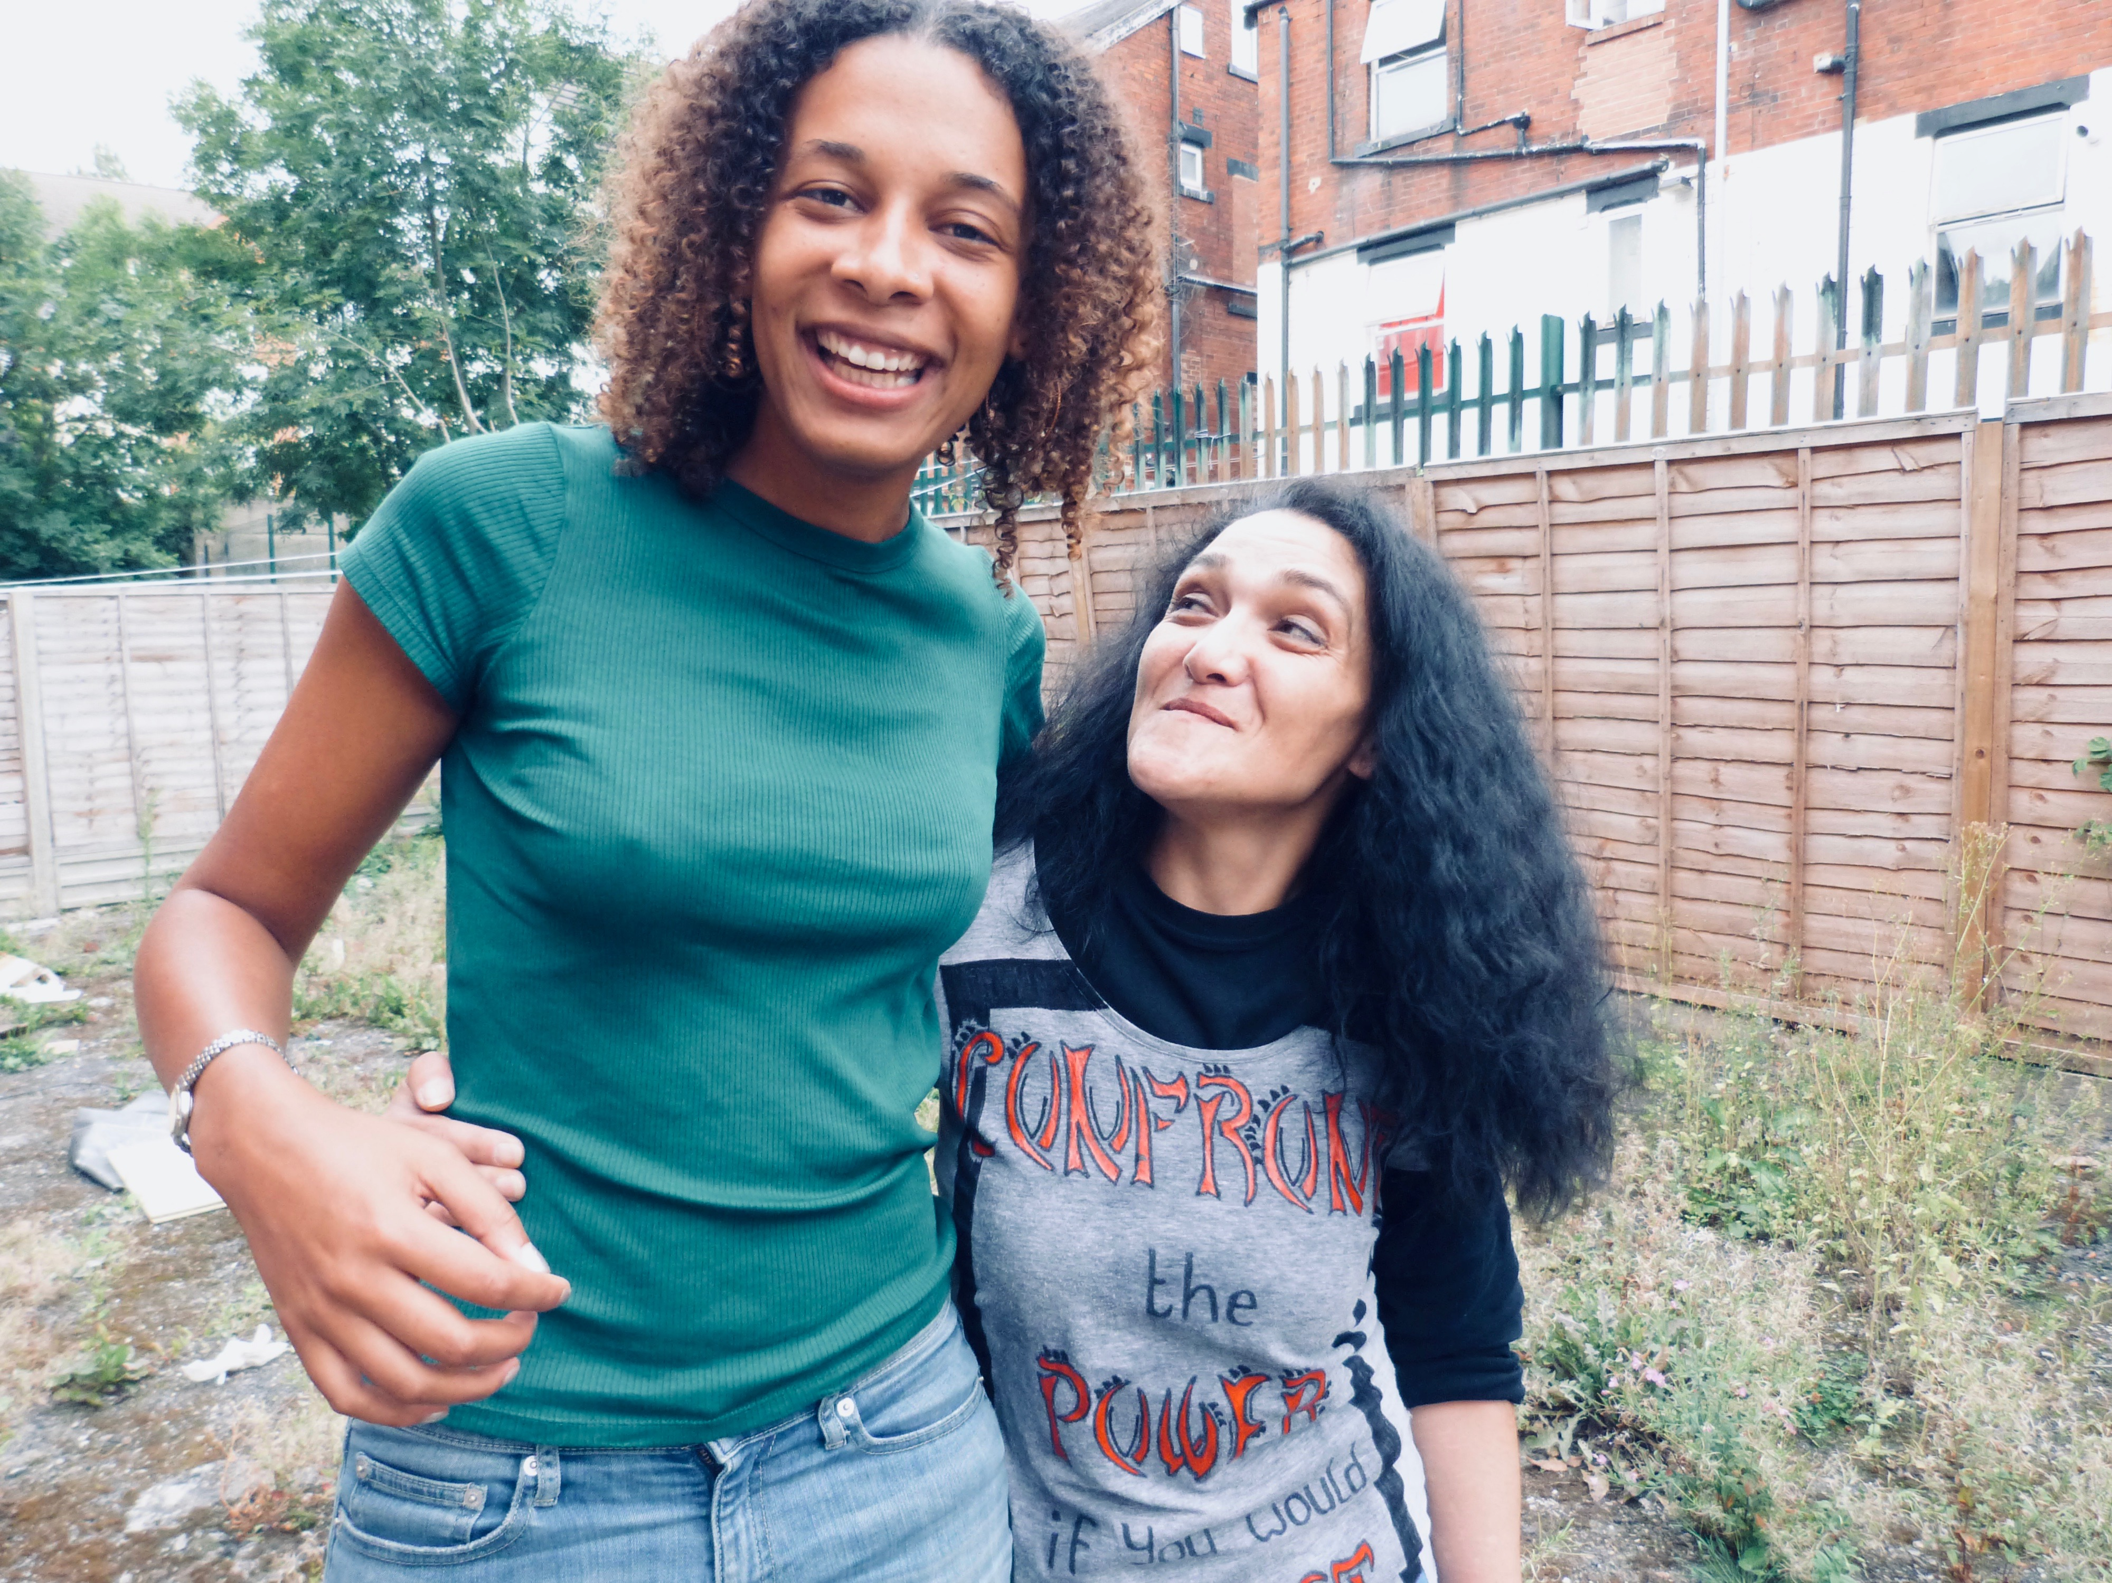
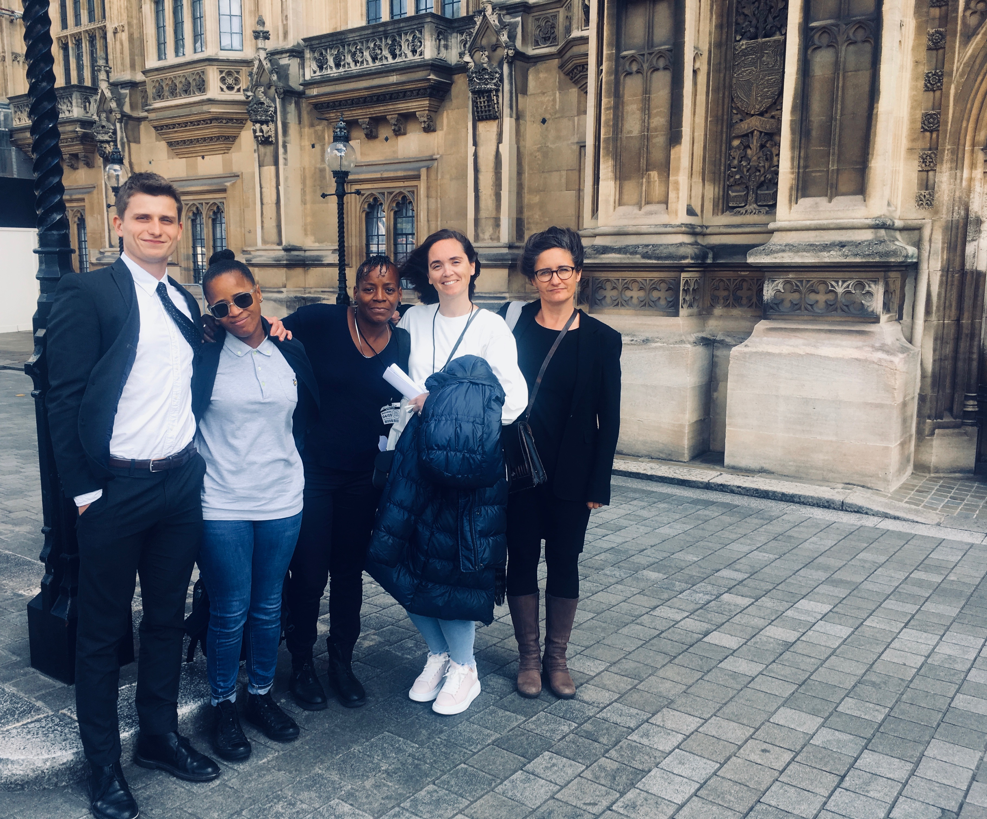
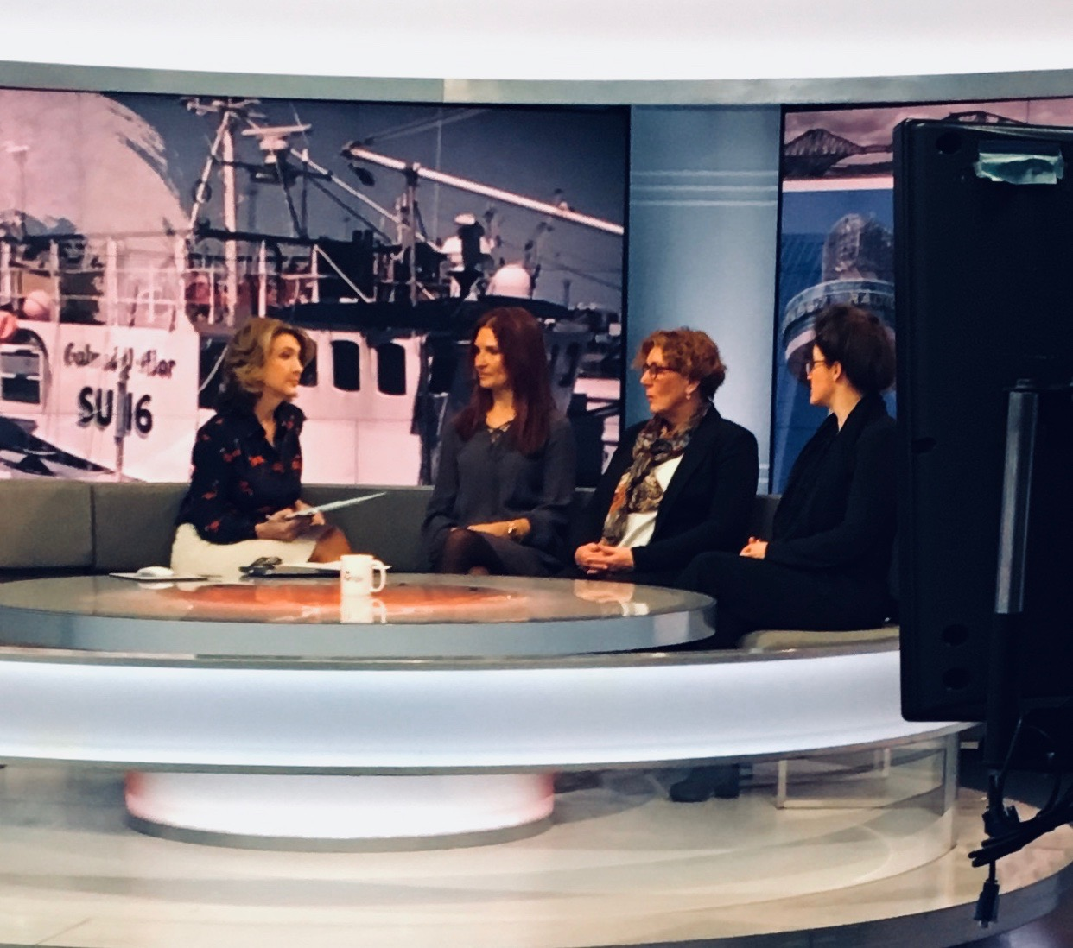

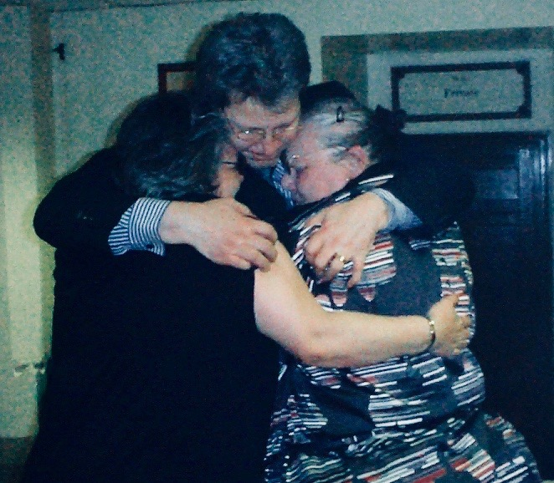

Slide 13

Impact via research that feeds law reform Trans-Atlantic example

Slide 14
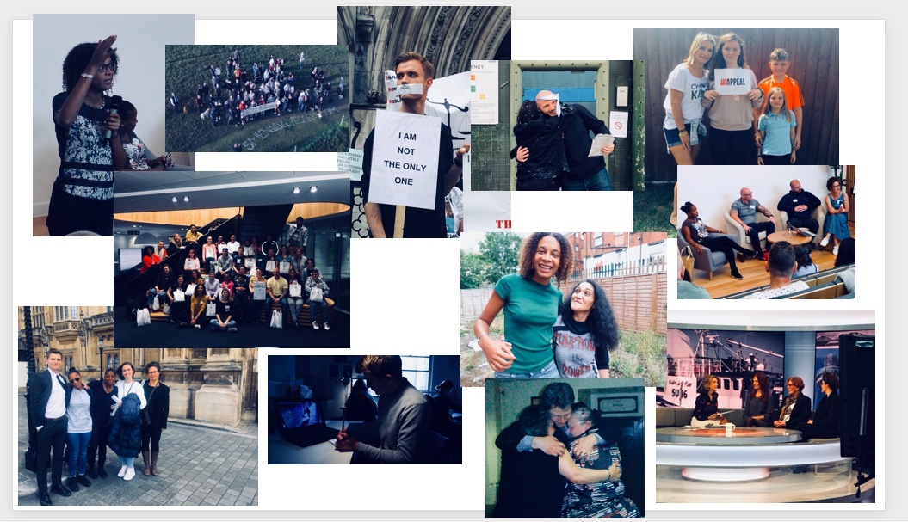
Non-profit law practice
Represent victims of miscarriages of justice
Philanthropically funded but with Legal Aid available
Strong pro bono component
Investigation-focused
Research
Campaign for system reform
Outsider perspective

Slide 15
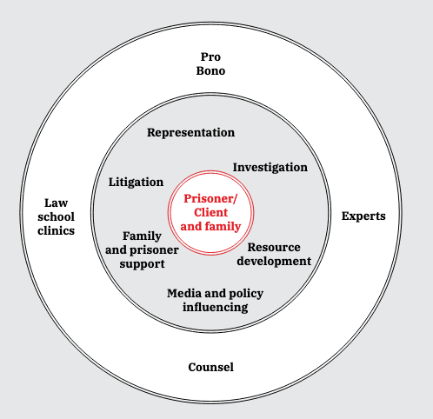

Slide 16
People in England and Wales are at far less risk of wrongful conviction or unfair sentencing, and all such wrongs are righted as a matter of urgency
Changes in the law, policy and practice so that the justice system becomes more transparent and accountable
Court cases
Political debate
Public outrage
Powerful voices
Fighting individual cases – investigation and representation
Inspiring the legal profession - training
Influencing politicians
Advocating in the media
Giving families strength and hope

Slide 17
Jury Verdicts

Slide 18
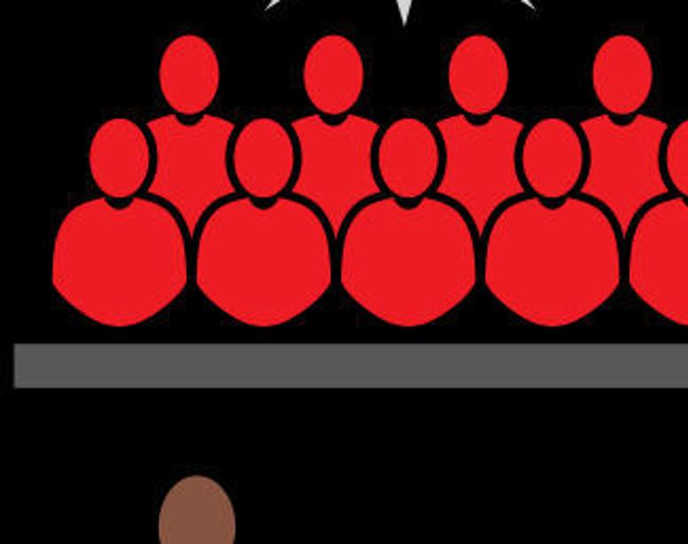
DOES THE JURY HAVE TO AGREE YOU ARE GUILTY TO CONVICT YOU?
NO

Slide 19
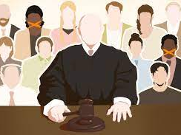
Divided Juries in the United States
Louisiana and Oregon
Louisiana Jim Crow Juries
1890s

Slide 20
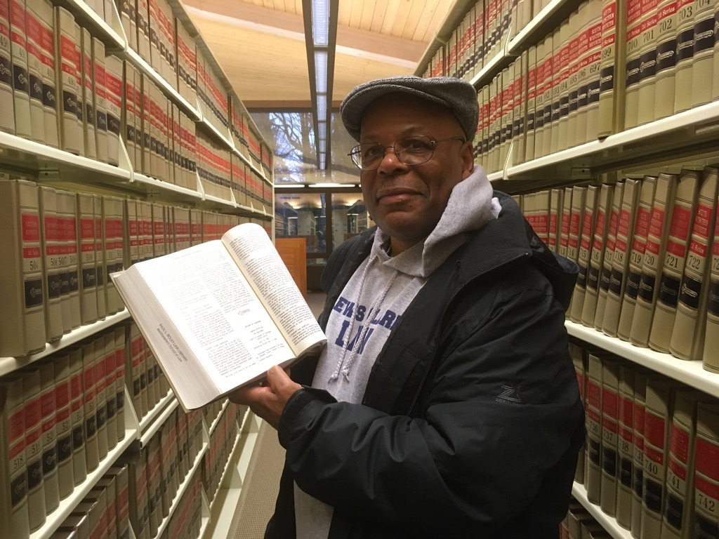
Lived experience driving reform: Calvin Duncan
-imprisoned for life for crime he did not commit
-jailhouse lawyer
-left prison in 2007
-law school
-Exonerated 2022
-divided juries

Slide 21
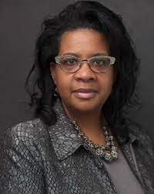
Research driving impact
Professor Angela Allen Bell (Southern University)
How the Narrative About Non-Unanimous Criminal Jury System Became a Person of Interest in the Case Against the Deep South
Rationale: efficiency
BUT
‘there was a finesse about drafting what appeared to be race-neutral legislation, which was, in fact, legislation that was racist to the core”
Data collected
40% of convictions on divided verdicts
Black defendants 30% more likely to be convicted on split verdict
Black jurors 2.5 times more likely than white jurors to dissent

Slide 22
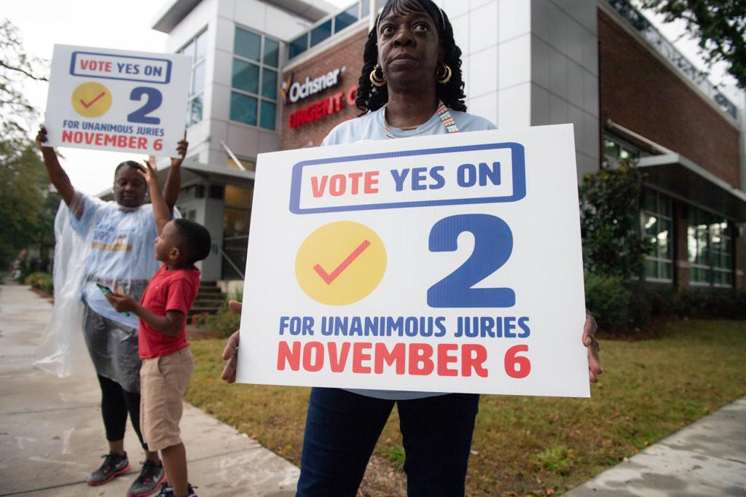
Impact: legislation
2018
Newspaper campaign
Campaign explicit that law was racist
Passed a state constitutional amendment
Prospective

Slide 23
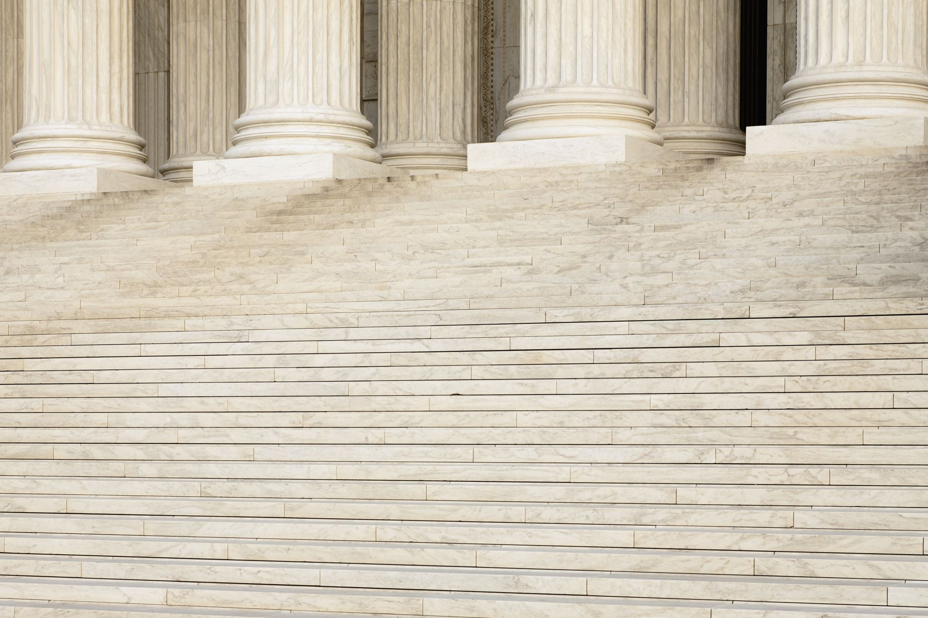
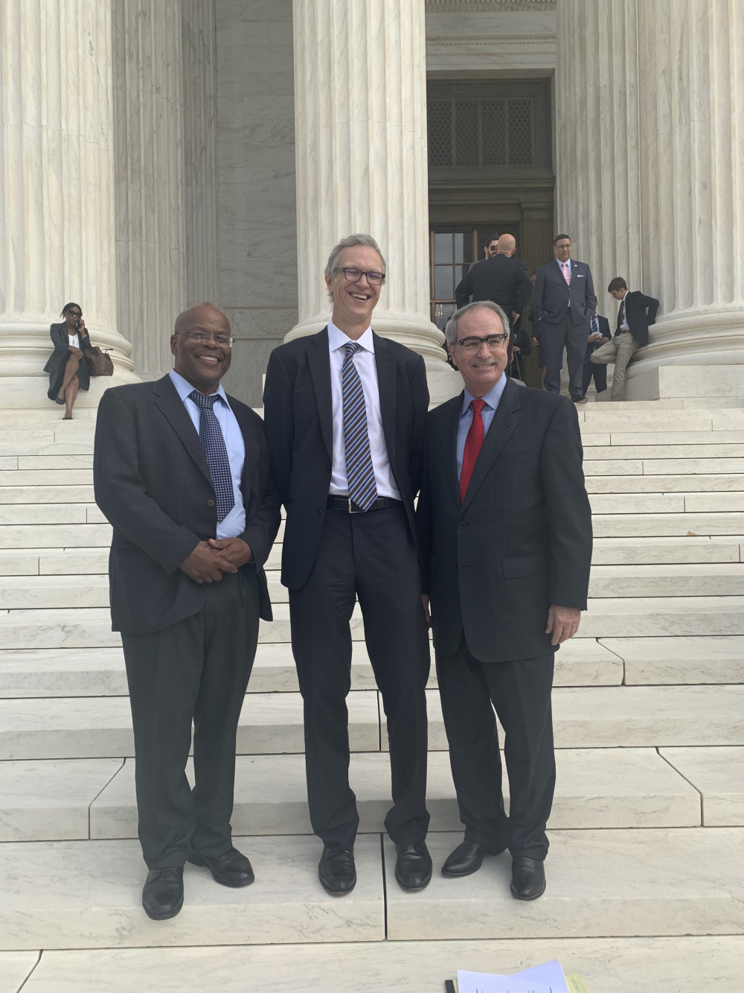
Impact: Legal Precedent
Ramos v Louisiana (2020)
denial of the Sixth Amendment right to trial by an impartial jury
non-unanimous verdicts could no longer be used to convict people of serious crimes
Some recognition that the origins of this practice were rooted in racial prejudice

Slide 24
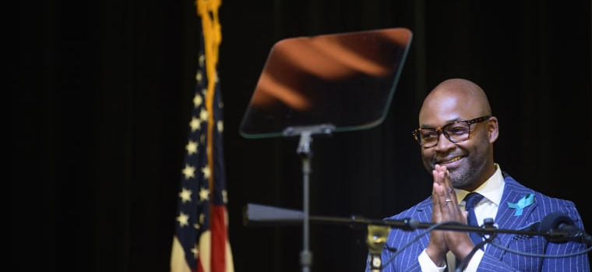
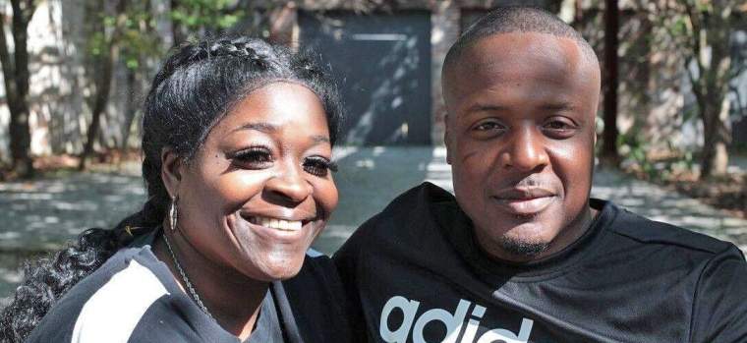
Impact: Individual lives and cases
-nearly two dozen cases from 1974-2014
-pleas to lesser time or retried
-1500 prisoners (80% black)
Jermaine Hudson (20 years) (maintained innocence)

Slide 25
Unanimity in England and Wales
10/2 verdicts accepted
But prior to 1967, a unanimous verdict was required, meaning that all 12 jurors had to agree

Slide 26
Why change?
Hansard shows justification given as :
Efficiency
Prevent jury nobbling

Slide 27
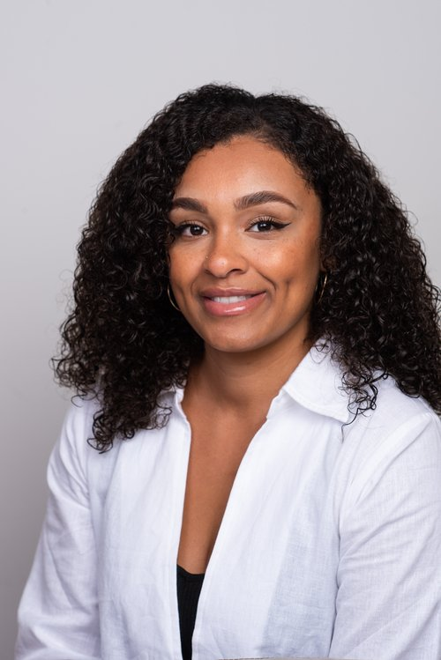
But really, why?
Nisha Waller (PhD candidate at Oxford University) and on staff at APPEAL
Team of advisors
Researching explore the potential connection between non-unanimous verdicts, race, and miscarriages of justice in England and Wales.

