Slide 1
Duty of Candour
Consequences of breach
Tom Hickman
April 2023

Slide 2
Consequences of breach
Consequences of defendant’s breach in HM, MA and KH’s cases
Claimant’s duty of candour
Ongoing nature of duty of candour

Slide 3
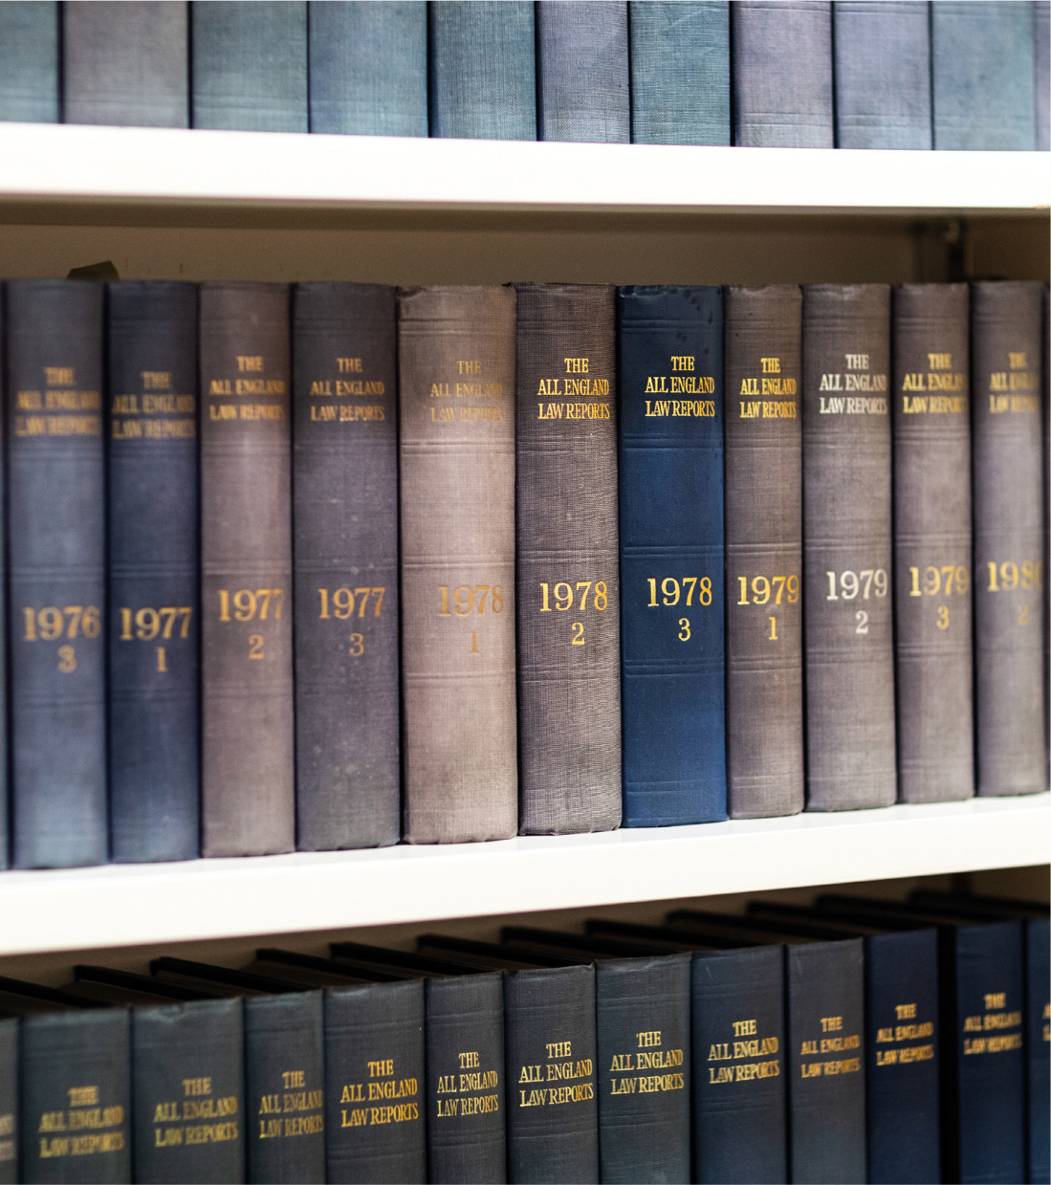
R ((1) HM, (2) MA & KH) v SSHD [2022] EWHC 2729 (Admin) (candour judgment)

Slide 4

Detailed finings about the candour breach
Sub heading
References to Counsel’s advice on drafts of PAP responses and AOS in HM’s case, that he had “side-stepped” and “ducked” the issue of the blanket policy (29, 30). The Court noted that this approach was not resisted by GLD or HO.
The documents to be candid should have volunteered the information that the blanket policy had existed but that it was no longer in effect at the time of the seizure (30). The DGR should have volunteered the full extent of the situation in clear terms (37)
In MA/KH’s case, the response failed to make clear that he seizures took place when blanket policy applied; instead of volunteering that information the documents conveyed the opposite impression (35)
Insert picture here

Slide 5

Section heading
Sub heading
Collective error of judgement
Suggestion given was that the assertion of a blanket policy was fanciful. That suggestion ought not to have been made. It was “excessively robust” (38, 39)
Approach to MA and KH’s case “very unsatisfactory” (40)

Slide 6
Section heading
Sub heading
Indemnity costs agreed but “we would also have made a costs order on an indemnity basis” (7)
Up to lifting of the stay in MA & KH’s claims
Waiver of privilege (6)
Statement from Counsel (6)
Investigation by the GLD (7)
Not apportioning blame and cannot do that fairly (9)
Unnecessary to do more than set out what has taken place in a public judgment (43)

Slide 7

Section heading
Sub heading
R (Khan) v SSHD [2016] EWCA Civ 416
(claimant’s duty of candour)

Slide 8
JR of an application for IRA based on 14 years continuous residence in UK.
Permission refused. Permission appealed to CA
Amongst documents before the SoS and filed was an application for a work permit in 2002 which included in answer to one question (Q14) that C had been employed for 4 years in a hotel in Pakistan. The JR grounds nonetheless asserted that there had been continuous residence.
Significance of 2002 application had been missed by Secretary of State until 2015 appeal to CA.

Slide 9
There is a duty on a claimant to disclose all material facts known to a claimant including those which are r appear to be adverse to his case (35).
A claimant must ensure that a judge dealing with permission has the full picture, notwithstanding JR is no longer ex parte (36, 45).
Claimants must disclose material documents even if they are unaware of the fact that they contain material facts (37).
The 2002 application had been disclosed but it was incumbent on C and his legal advisers to draw the attention of those considering the application for judicial review to the answer to Q14, and its inconsistency with other evidence. That inconsistency required the C to address it in a witness statement (48)

Slide 10
Continuing duty of candour

Slide 11
Continuing duty of candour
Khan:
“the duty of candour is a continuing one. It includes a duty to reassess the viability and propriety of a challenge in the light of the respondents acknowledgment of service and summary grounds.”
British Gas, Scottish Power, E.ON:
Disclosure during course of proceedings does not mean that there was a breach of the duty of candour.

Slide 12
Telephone: +44(0) 207 583 1770
Email: clerks@blackstonechambers.com
www.blackstonechambers.com

