Slide 1
How to get Exceptional Case Funding in immigration cases Siobhan Foulner Solicitor Wilson Solicitors LLP
Wilsons:
Content by Katy Watts – Solicitor at Liberty

Slide 2
Background
Legal Aid, Sentencing and Punishment of Offenders Act 2012 (LASPO)
“The exceptional funding scheme will ensure that legal aid will be available where required—those cases in which people genuinely could not manage by themselves, and in which a failure to provide legal aid would be likely to breach an individual’s right to legal aid under the Human Rights Act 1998 or EU law.”
(Commons Committee, 8th sitting, 6 September 2011, Column 349)
Wilsons:

Slide 3
In-scope immigration proceedings
Civil legal services funded ‘within scope’ of s9 LASPO are set out in Schedule 1 LASPO
The types of immigration cases left in scope for legal aid are set out in paragraphs 24 – 32A of Schedule 1 LASPO
Broadly – refugee law and other protection claims, victims of domestic violence, victims of trafficking or modern slavery, immigration detention and most immigration judicial review.
Wilsons:

Slide 4
ECF for immigration cases
Everything which is not within scope of Schedule 1 LASPO is an ‘excluded matter’ and may potentially be funded as an ‘exceptional case’ under s10 LASPO.
In immigration cases, this is likely to mean: claims based on Article 8, applications based on EU law, deportation cases, applications for British citizenship and family reunion applications.
The case must also satisfy the same merits, means and any other regulations made under LASPO.
Wilsons:

Slide 5
The Statutory Scheme
(1) Civil legal services other than services described in Part 1 of Schedule 1 are to be available to an individual under this Part if subsection (2) or (4) is satisfied.
(2) This subsection is satisfied where the Director –
(a) has made an exceptional case determination in relation to the individual and the services, and
(b) has determined that the individual qualifies for the services in accordance with this Part (and has not withdrawn either determination).
(3) For the purposes of subsection (2), an exceptional case determination is a determination –
(a) that it is necessary to make the services available to the individual because failure to do so would be a breach of –
(i) The individuals’ Convention rights (within the meaning of the Human Rights Act 1998), or
(ii) Any rights of the individual to the provision of legal services that are enforceable EU rights, or
(b) that it is appropriate to do so, in the particular circumstances of the case, having regard to any risk that failure to do so would be such a breach.
Wilsons:
Notes:
So the critical question is when would a failure to have legal aid be a breach of an individual’s human rights?

Slide 6
Gudanaviciene v Director of Legal Aid Casework [2014 EWCA Civ 1622]
Challenge to the lawfulness of the ECF guidance used by Legal Aid Agency caseworkers to decide applications for ECF
When should ECF be made available?
“Para 10 [of the Guidance] states that the threshold for a breach of an applicant’s rights under article 6(1) is ‘very high’. Para 12 states that in certain ‘very limited’ circumstances, legal aid may be required in order to guarantee right of access to a court in civil proceedings. Para 18 states that the X v UK test is a ‘very high threshold’” (paragraph 44). However, this “is to misstate the effect of the ECtHR jurisprudence.” (paragraph 45)
“the critical question is whether an unrepresented litigant is able to present his case effectively and without obvious unfairness.” (paragraph 56)
Wilsons:
Notes:
Old news – but the principles are still relevant when making ECF applications, and the judgment as a whole is worth reading!

Slide 7
Gudanaviciene v Director of Legal Aid Casework [2014 EWCA Civ 1622]
General Principles
“the question is whether the applicant’s appearance before the court or tribunal in question without the assistance of a lawyer was effective, in the sense of whether he or she was able to present the case satisfactorily.”(paragraph 46)
“it is relevant whether the proceedings taken as a whole were fair” (paragraph 46)
“the importance of the appearance of fairness is also relevant: simply because an applicant can struggle through ‘in the teeth of all the difficulties’ does not necessarily mean that the procedure was fair” (paragraph 46)
“Equality of arms must be guaranteed to the extent that each side is afforded a reasonable opportunity to present his or her case under conditions that do not place them at a substantial disadvantage vis-à-vis their opponent” (paragraph 46)
Wilsons:

Slide 8
Gudanaviciene - immigration cases
“The article 8 test is broader than the article 6(1) test [in that it does not require a hearing before a court or tribunal, but only involvement in the decision-making process] but in practice we doubt whether there is any real difference between the two formulations in the context with which we are concerned.” (paragraph 70)
“The following features of immigration proceedings are relevant: (i) there are statutory restrictions on the supply of advice and assistance … (ii) individuals may well have language difficulties; and (iii) the law is complex and rapidly evolving” (paragraph 72)
“It will often be the case that a decision to deport will engage an individual’s article 8 rights. Where this occurs, the individual will usually be able to say that the issues at stake for him are of great importance.”(paragraph 77)
Wilsons:

Slide 9
The ECF criteria
“The answer to this [question] requires a consideration of all the
circumstances of the case … These factors must be carefully weighed. Thus
the greater the complexity of the procedural rules and/or the substantive
legal issues, the more important was it at stake and the less able the
applicant may be to cope with the stress, demands and complexity of the
proceedings, the more likely it is that article 6(1) will require the provision
of legal services.” (paragraph 56)
“(a) the importance of the issues at stake; (b) the complexity of the
procedural, legal and evidential issues; and (c) the ability of the individual
to represent himself without legal assistance, having regard to his age and
mental capacity.” (paragraph 72)
Wilsons:

Slide 10
Applying the ECF criteria
Importance: will almost always be met in immigration cases where the applicant’s right to remain or enter the UK is at stake
Complexity: the LAA increasingly accept that immigration cases are complex, even at application stage
Ability: all the following may be evidence of an applicant’s inability to effectively engage - physical and mental health, level of education, ability to communicate in English, emotive issues, precarious living situation
Wilsons:

Slide 11

Practicalities – Form ECF1
Urgency – Provider Pack states that urgent applications will be considered within ten working days
Consider requesting an adjournment in very urgent cases
ECF can be backdated
Wilsons:
Notes:
Backdating – less risk in immigration than in other cases – 75% success rate.

Slide 12

Practicalities – Form ECF1
Individual case contracts
Effective administration of justice test must be met
R31(5) Civil Legal Aid (Procedure) Regulations 2012
Wilsons:

Slide 13
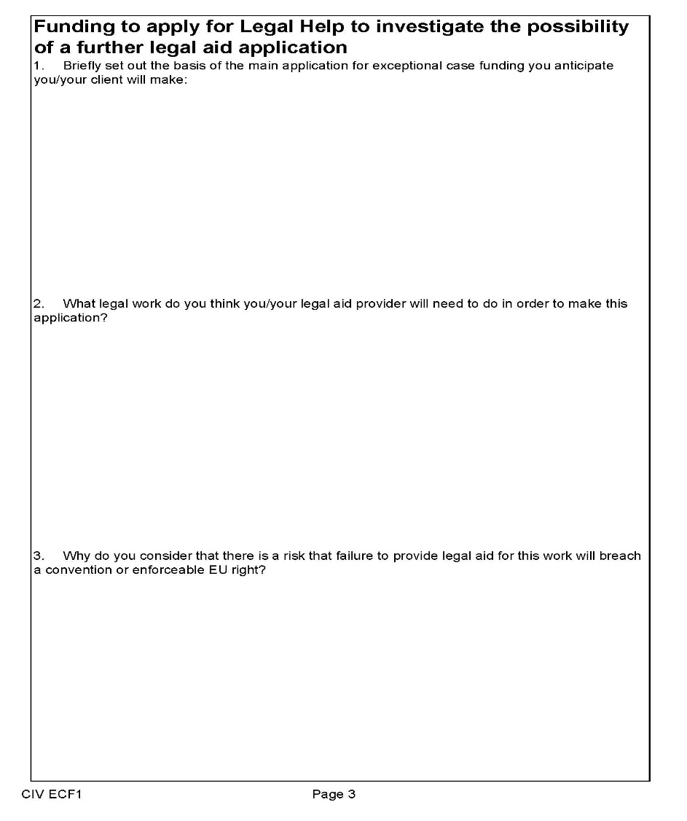
Practicalities – Form ECF1
“ECF for ECF”
Legal Help is available where investigative work is necessary to determine whether ECF is required
Possible to claim disbursements under a Legal Help for ECF matter,
Wilsons:

Slide 14
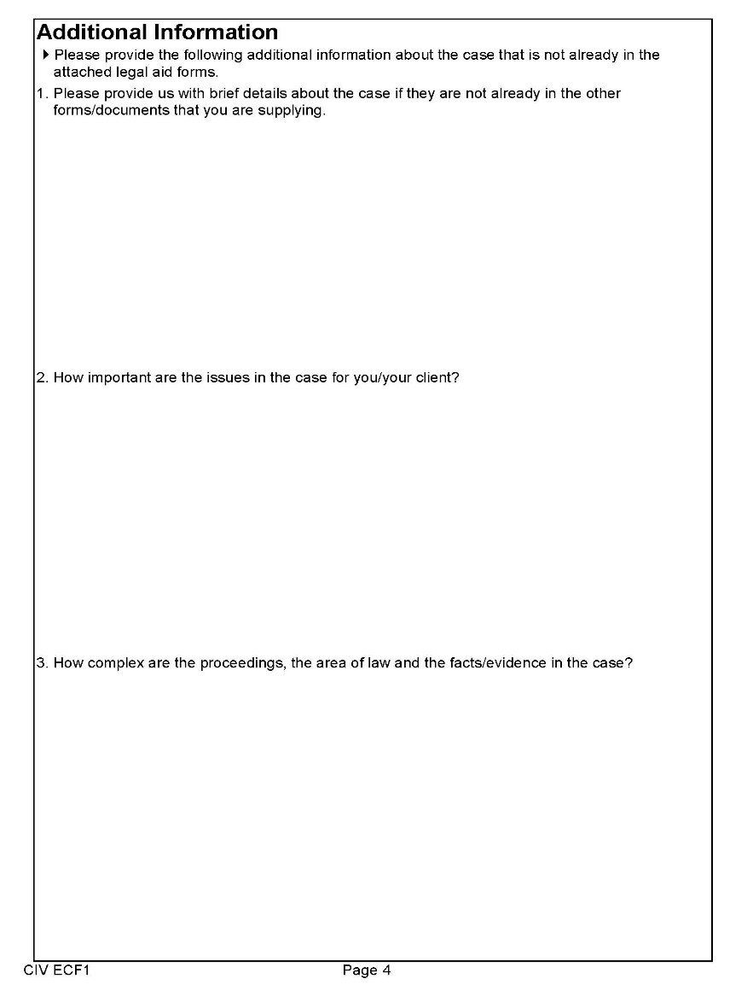

Practicalities – Form ECF1
Wilsons:

Slide 15
Practicalities - forms
Providers must submit the relevant means and merits forms for the category of case and level of service applied for
On referral to a provider, the provider must:
submit any new information that is relevant to the grant of funding – in practice the provider should carry out their own means assessment
complete and sign/date the CW1/CW2 form, complete and sign/date the CIVECF1 form, then send a copy of these forms to the ECF Team, together with a copy of the determination letter
Wilsons:

Slide 16
What to do if you application is refused
Applicants can apply to the LAA within 14 days for an internal review of a refusal to grant ECF
Use form APP9E, which should be supplied with any refusal
LAA aims to process applications for internal review within 10 working days
No further right of review; a refusal to grant ECF on internal review can only be challenged by judicial review
Wilsons:

Slide 17
Further resources
Form ECF1: https://assets.publishing.service.gov.uk/government/uploads/system/uploads/attachment_data/file/879163/CIVECF1_form_fillable.pdf
Lord Chancellor’s Guidance: https://www.gov.uk/government/uploads/system/uploads/attachment_data/file/477317/legal-aid-chancellor-non-inquests.pdf
Provider Information Pack: https://assets.publishing.service.gov.uk/government/uploads/system/uploads/attachment_data/file/879071/ECF_Provider_Pack_March_2020_Amendments__002_.pdf
PLP guide to accessing ECF in immigration cases: https://publiclawproject.org.uk/wp-content/uploads/2018/07/PLP-ECF-Immigration-Guide.pdf
Wilsons:

Slide 18
ANY QUESTIONS?
Wilsons:

