Slide 1




Exceptional Case Funding
(and other ways to fund cases in housing-adjacent categories of law)
Simon Mullings
@spikemullings

Slide 2
Gudanaviciene v Director of Legal Aid Casework [2014 EWCA Civ 1622]
(§72)
Whether legal aid is required will depend on the particular facts and circumstances of each case, including
(a) the importance of the issues at stake;
(b) the complexity of the procedural, legal and evidential issues; and
(c) the ability of the individual to represent himself without legal assistance, having regard to his age and mental capacity.
Importance – Complexity - Ability
Simon Mullings
@spikemullings

Slide 3
The basic structure of civil legal aid
Contracts with the legal aid agency
Housing and debt
Welfare benefits
Public law
Types of assistance-
Legal Help
Investigative Help/Legal Representation
Simon Mullings
@spikemullings

Slide 4
The basic structure of civil legal aid
Means testing
In scope/out of scope
Legal Aid, Sentencing and Punishment of Offenders Act 2012 – section 9:
9 General cases
(1) Civil legal services are to be available to an individual under this Part if—
(a) they are civil legal services described in Part 1 of Schedule 1
Simon Mullings
@spikemullings

Slide 5
The basic structure of civil legal aid
LASPO
Schedule 1
Part 1 - case types that are in scope, subject to exclusions
Part 2 - case types that are excluded
Part 3 - advocacy exclusions and exceptions
Part 4 - interpretation
Simon Mullings
@spikemullings

Slide 6
Housing legal aid
Housing – what is in scope?
Possession proceedings
Eviction
Homelessness (incl. allocation and community care)
Housing conditions/disrepair (but not money claims)
Anti-social behaviour injunctions
Harassment
Simon Mullings
@spikemullings

Slide 7
Housing legal aid
Problem?
Legal Aid Handbook 2021/22, LAG 2022.
12:13 Many possession cases involving rent arrears will have, as the underlying cause or a contributor to it, problems with housing benefit or housing element of universal credit. LASPO Sch 1 Part 1 para 33(3) applies the Part 2 scope exclusions, [. . . ]
Simon Mullings
@spikemullings

Slide 8
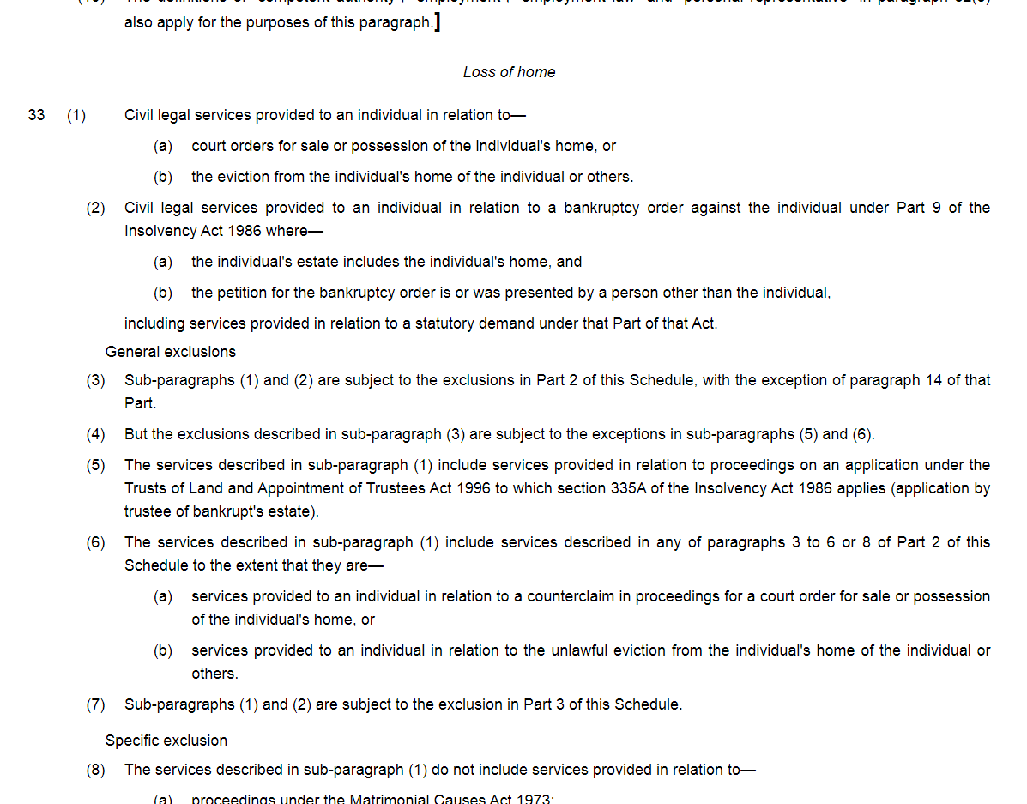

Slide 9
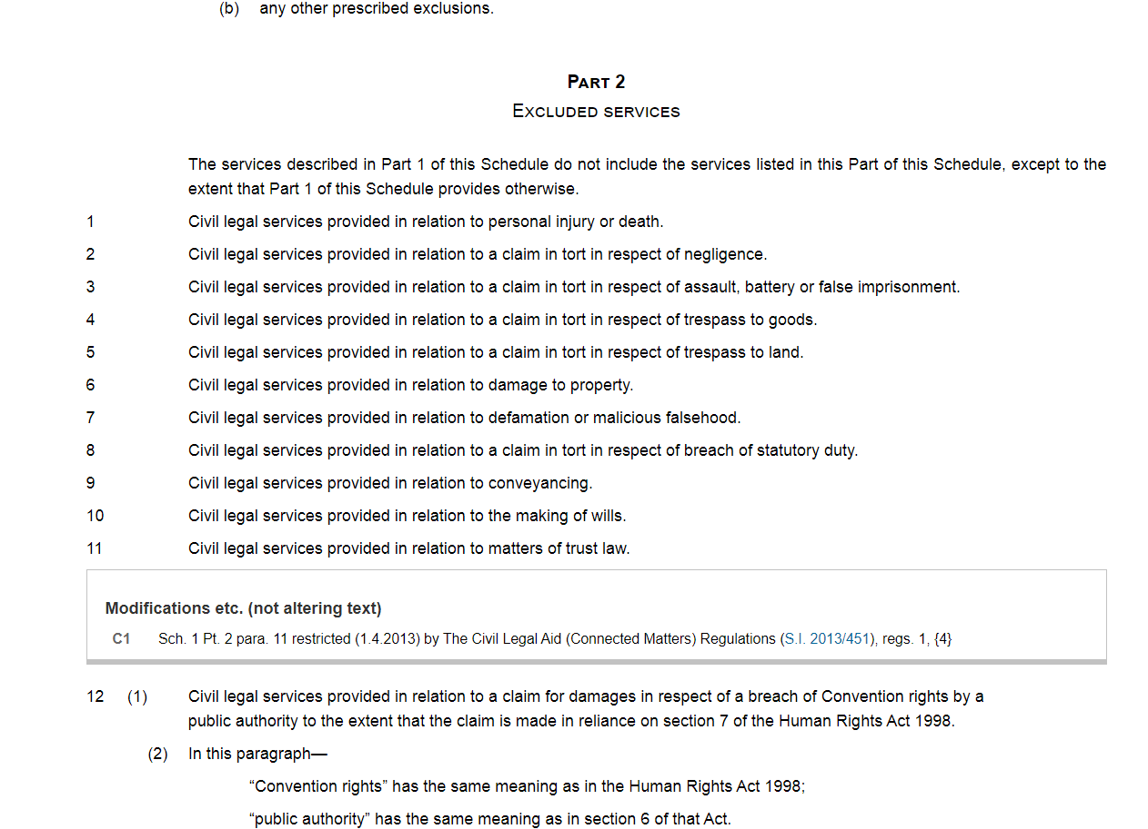

Slide 10
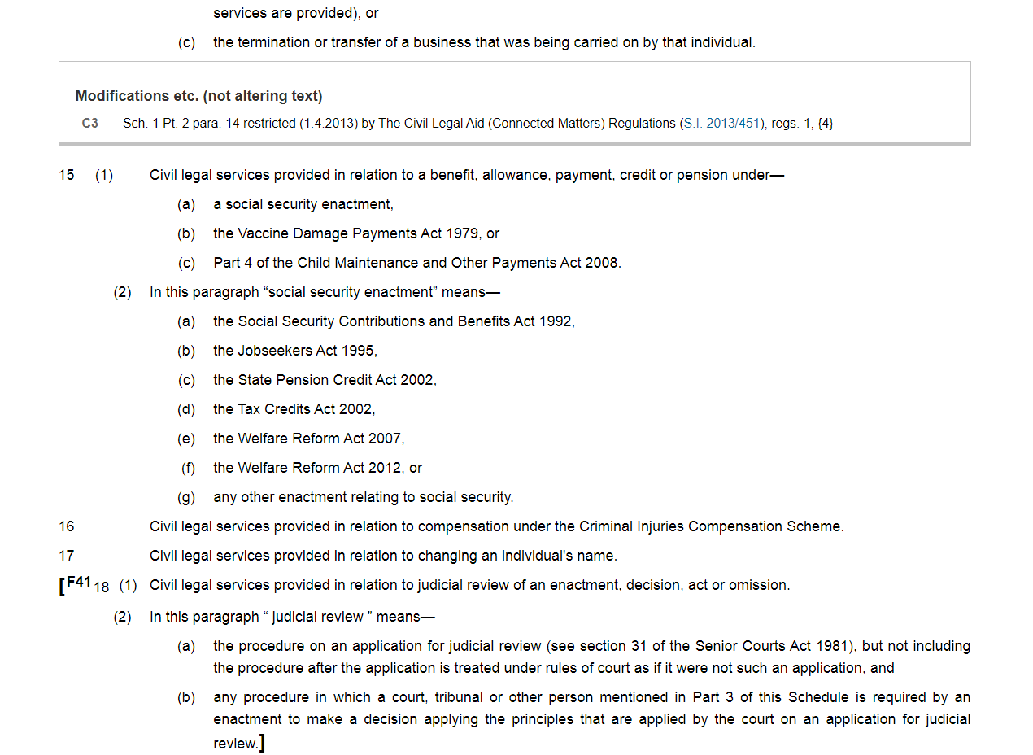

Slide 11
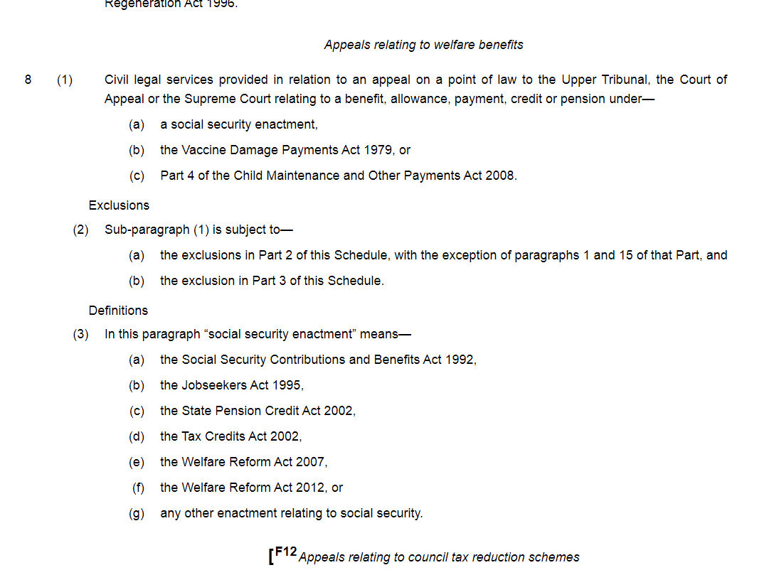

Slide 12
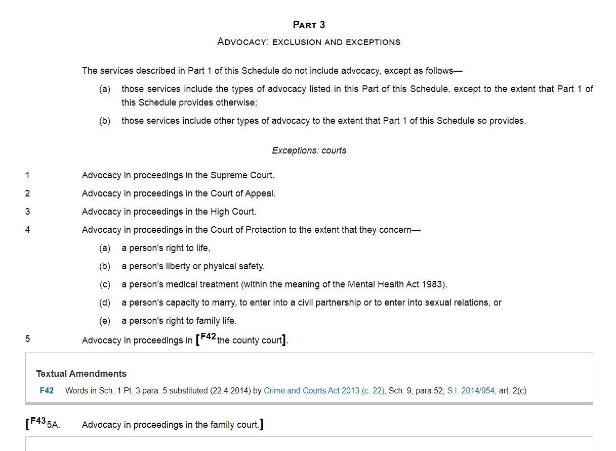

Slide 13
Housing legal aid
Problem
Legal Aid Handbook 2021/22, Legal Action Group 2022.
12:13 Many possession cases involving rent arrears will have, as the underlying cause or a contributor to it, problems with housing benefit or housing element of universal credit. LASPO Sch 1 Part 1 para 33(3) applies the Part 2 scope exclusions, including the welfare benefits exclusion. The effect of this is that work done in relation to the possession proceedings is in scope, but work done in relation to welfare benefits is out of scope. You can investigate the housing benefit or universal credit position to prepare a defence to the possession matter – which may include preparing witness statements, or even summonsing housing benefits or Department for Work and Pensions (DWP) officers – and can seek an adjournment for the client to resolve the benefits matter themselves. However, any work in assisting the client with that resolution will not be claimable.
Simon Mullings
@spikemullings

Slide 14
ECF
Legal Aid, Sentencing and Punishment of Offenders Act 2012
“The exceptional funding scheme will ensure that legal aid will be available where required—those cases in which people genuinely could not manage by themselves, and in which a failure to provide legal aid would be likely to breach an individual’s right to legal aid under the Human Rights Act 1998 or EU law.”
(Commons Committee, 8th sitting, 6 September 2011, Column 349)
Simon Mullings
@spikemullings

Slide 15
ECF
Legal Aid, Sentencing and Punishment of Offenders Act 2012
10 Exceptional cases
  (1) Civil legal services other than services described in Part 1 of Schedule 1 are to be available to an individual under this Part if subsection (2) or (4) is satisfied.
  (2) This subsection is satisfied where the Director—
    (a) has made an exceptional case determination in relation to the individual and the services, and
    (b) has determined that the individual qualifies for the services in accordance with this Part, (and has not withdrawn either determination).
  (Sub-section 4 deals with inquests so beyond the scope of this seminar)
Simon Mullings
@spikemullings

Slide 16
ECF
Legal Aid, Sentencing and Punishment of Offenders Act 2012
10 Exceptional cases
  (3) For the purposes of subsection (2), an exceptional case determination is a determination—
    (a) that it is necessary to make the services available to the individual under this Part because failure to do so would be a breach of—
      (i) the individual's HRA Convention rights, or
      (ii) retained enforceable EU rights,
    (b) that it is appropriate to do so, in the particular circumstances of the case, having regard to any risk that failure to do so would be such a breach.
Simon Mullings
@spikemullings

Slide 17
ECF
Legal Aid, Sentencing and Punishment of Offenders Act 2012
    necessary to make the services available to the individual under this Part because failure to do so would be a breach of—
      the individual's Convention rights
      any rights of the individual to the provision of legal services that are retained enforceable EU rights,
Two concepts:
HRA and EU rights which deal with rights to fair trial or other procedural determination of rights
The rights themselves
Simon Mullings
@spikemullings

Slide 18
What to consider before ECF
Is the work the definitely out of scope? In respect of a housing contract, see previous slide on witness summonsing housing benefit or DWP officers for example.
Public Law - could the work be covered by you public law contract, if you have one, because, for example it concerns a matters which could be justiciable by judicial review (s.19 of part 1 sched 1)? If so it is not out of scope and so not amenable to ECF. Similarly Abuse of public office (21) and Breach of convention rights (22).
Simon Mullings
@spikemullings

Slide 19
HLPAS
HLPAS (Housing Loss Prevention Advice Service).
Currently subject to consultation.
HLPAS will comprise of the current Housing Possession Court Duty Scheme but with early non-means-tested, free legal advice available before the possession hearing.
Legal advice on the issues that are relevant to the possession proceedings.
Most often going to be welfare benefits and/or debt advice, which has, since the 2013 LASPO1 reforms, been out of scope for mainstream face-to-face advice and assistance.
Simon Mullings
@spikemullings

Slide 20
ECF
Applications
 |  | Category of Law
Financial Year | Quarter | Debt/ Consumer/ Contract | Discrimination | Education | Family | Housing/ Land Law | Immigration | Inquest | Inquiry/ Tribunal | Other | PI/ Clinical Negligence | Welfare Benefits | Total
2013-14 |  | 6 | 1 | 2 | 819 | 80 | 234 | 201 | 13 | 84 | 65 | 11 | 1,516
2014-15 |  | 0 | 0 | 3 | 464 | 29 | 334 | 225 | 3 | 94 | 2 | 18 | 1,172
2015-16 |  | 0 | 0 | 0 | 394 | 54 | 493 | 240 | 0 | 155 | 1 | 7 | 1,344
2016-17 |  | 2 | 4 | 0 | 305 | 48 | 1,008 | 288 | 0 | 196 | 8 | 20 | 1,879
2017-18 |  | 3 | 5 | 0 | 351 | 51 | 1,556 | 354 | 0 | 188 | 27 | 26 | 2,561
2018-19 |  | 10 | 2 | 0 | 355 | 56 | 1,947 | 417 | 0 | 195 | 3 | 25 | 3,010
2019-20 (r) |  | 10 | 3 | 0 | 440 | 52 | 2,528 | 443 | 0 | 238 | 5 | 32 | 3,751
2020-21 (r) |  | 2 | 1 | 0 | 432 | 76 | 2,336 | 267 | 0 | 184 | 8 | 29 | 3,335
Grants
 |  | Category of Law
Financial Year | Quarter | Debt/ Consumer/ Contract | Discrimination | Education | Family | Housing/ Land Law | Immigration | Inquest | Inquiry/ Tribunal | Other | PI/ Clinical Negligence | Welfare Benefits | Total
2013-14 |  | 0 | 0 | 0 | 9 | 1 | 4 | 54 | 1 | 1 | 0 | 0 | 70
2014-15 |  | 0 | 0 | 0 | 48 | 3 | 57 | 110 | 1 | 7 | 0 | 3 | 229
2015-16 |  | 0 | 0 | 0 | 156 | 2 | 326 | 165 | 0 | 16 | 1 | 2 | 668
2016-17 |  | 0 | 0 | 0 | 100 | 7 | 693 | 165 | 0 | 7 | 1 | 8 | 981
2017-18 (r) |  | 0 | 0 | 0 | 127 | 10 | 1,086 | 175 | 0 | 11 | 1 | 10 | 1,420
2018-19 |  | 2 | 0 | 0 | 143 | 12 | 1,534 | 243 | 0 | 17 | 2 | 10 | 1,963
2019-20 |  | 2 | 0 | 0 | 193 | 15 | 2,033 | 281 | 0 | 32 | 1 | 19 | 2,576
2020-21 (r) |  | 0 | 0 | 0 | 170 | 31 | 2,020 | 172 | 0 | 37 | 0 | 22 | 2,452
Other determinations and breakdown by non-grant reason available.
¹ Grants in this section only include full granted applications, and not part-grants or cases with a Positive Preliminary View.
(r) Revised from previous published figures.

Slide 21
ECF
 | Applications | Grants | % granted
13-14 | 1516 | 70 | 4.6
14-15 | 1172 | 229 | 19.5
15-16 | 1344 | 668 | 49.7
16-17 | 1879 | 981 | 52.2
17-18 | 2561 | 1420 | 55.4
18-19 | 3010 | 1963 | 65.2
19-20 | 3751 | 2576 | 68.7
20-21 | 3335 | 2452 | 73.5

Slide 22
Gudanaviciene v Director of Legal Aid Casework [2014 EWCA Civ 1622]
Simon Mullings
@spikemullings
Notes:
Old news – but the principles are still relevant when making ECF applications, and the judgment as a whole is worth reading!

Slide 23
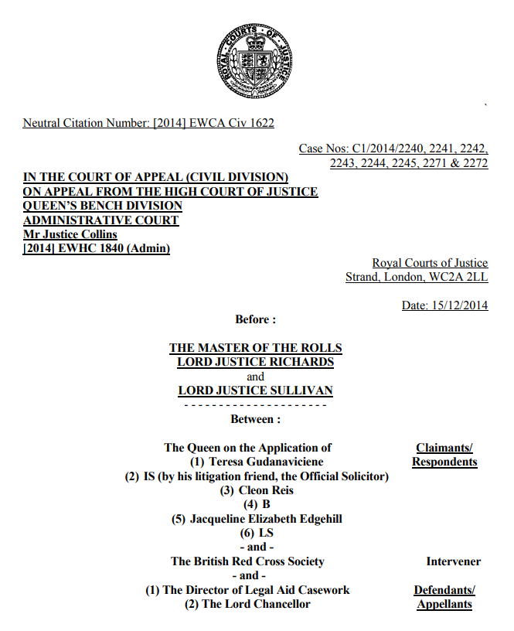

Slide 24
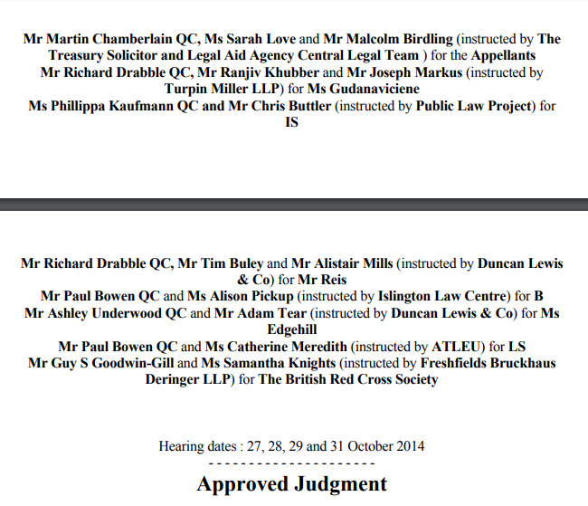

Slide 25
Gudanaviciene v Director of Legal Aid Casework
[2014 EWCA Civ 1622]
Challenge to the lawfulness of the ECF guidance used by Legal Aid Agency caseworkers to decide applications for ECF
When should ECF be made available?
(§44). “Para 10 [of the Guidance] states that the threshold for a breach of an applicant’s rights under article 6(1) is ‘very high’. Para 12 states that in certain ‘very limited’ circumstances, legal aid may be required in order to guarantee right of access to a court in civil proceedings. Para 18 states that the X v UK test is a ‘very high threshold’”
(§45) However, this “is to misstate the effect of the ECtHR jurisprudence.”
(§ 56)“the critical question is whether an unrepresented litigant is able to present his case effectively and without obvious unfairness.”
Simon Mullings
@spikemullings
Notes:
Old news – but the principles are still relevant when making ECF applications, and the judgment as a whole is worth reading!

Slide 26
Gudanaviciene v Director of Legal Aid Casework
[2014 EWCA Civ 1622]
General Principles
§46 - The general principles established by the ECtHR are now clear. Inevitably, they are derived from cases in which the question was whether there was a breach of article 6(1) in proceedings which had already taken place. We accept the following summary of the relevant case-law given by Mr Drabble:
  the Convention guarantees rights that are practical and effective, not theoretical and illusory in relation to the right of access to the courts (Airey para 24, Steel and Morris para 59);
  (ii) the question is whether the applicant's appearance before the court or tribunal in question without the assistance of a lawyer was effective, in the sense of whether he or she was able to present the case properly and satisfactorily (Airey para 24, McVicar para 48 and Steel and Morris para 59);
Simon Mullings
@spikemullings

Slide 27
Gudanaviciene v Director of Legal Aid Casework
[2014 EWCA Civ 1622]
General Principles
§46 cont.
  (iii) it is relevant whether the proceedings taken as a whole were fair (McVicar para 50, P,C and S para 91);
  (iv) the importance of the appearance of fairness is also relevant: simply because an applicant can struggle through "in the teeth of all the difficulties" does not necessarily mean that the procedure was fair (P,C and S para 91);
  and (v) equality of arms must be guaranteed to the extent that each side is afforded a reasonable opportunity to present his or her case under conditions that do not place them at a substantial disadvantage vis-à-vis their opponent (Steel and Morris para 62).
Simon Mullings
@spikemullings

Slide 28
Gudanaviciene v Director of Legal Aid Casework
[2014 EWCA Civ 1622]
ARTICLE 6 Right to a fair trial
1. In the determination of his civil rights and obligations or of any criminal charge against him, everyone is entitled to a fair and public hearing within a reasonable time by an independent and impartial tribunal established by law
ARTICLE 8 Right to respect for private and family life
1. Everyone has the right to respect for his private and family life, his home and his correspondence.
(§70) “The focus of article 6(1) is to ensure a fair determination of civil rights and obligations by an independent and impartial tribunal. Article 8 does not dictate the form of the decision-making process that the state must put in place. But the focus of the procedural aspect of article 8 is to ensure the effective protection of an individual's article 8 rights. To summarise, in determining what constitutes effective access to the tribunal (article 6(1)) and what constitutes sufficient involvement in a decision-making process (article 8), for present purposes the standards are in practice the same.”
Simon Mullings
@spikemullings

Slide 29
The ECF criteria
Gudanaviciene v Director of Legal Aid Casework
[2014 EWCA Civ 1622]
(§56) “It can therefore be seen that the critical question is whether an unrepresented litigant is able to present his case effectively and without obvious unfairness. The answer to this question requires a consideration of all the circumstances of the case … These factors must be carefully weighed. Thus the greater the complexity of the procedural rules and/or the substantive legal issues, the more important was it at stake and the less able the applicant may be to cope with the stress, demands and complexity of the proceedings, the more likely it is that article 6(1) will require the provision of legal services.”
(§72) “Whether legal aid is required will depend on the particular facts and circumstances of each case, including (a) the importance of the issues at stake; (b) the complexity of the procedural, legal and evidential issues; and (c) the ability of the individual to represent himself without legal assistance, having regard to his age and
mental capacity.”
Simon Mullings
@spikemullings

Slide 30
Applying the ECF criteria
Importance: the issue is the importance of the outcome to your client.
Complexity: this is social welfare law – there is always complexity! But especially so with welfare benefits law.
Ability: important to provide all evidence of an applicant’s inability to effectively participate - physical and mental health, level of education, ability to communicate in English, emotive issues, precarious living situation etc. But of course complexity is also relevant.
Simon Mullings
@spikemullings

Slide 31
Practicalities
Legal Help
Legal Representation / Investigative Help
Simon Mullings
@spikemullings

Slide 32
Practicalities
Legal Help
Email CIVECF1, CWORK1 and supporting documents to ContactECC@justice.gov.uk
Simon Mullings
@spikemullings

Slide 33

Practicalities – Form ECF1
Urgency – Provider Pack states that urgent applications will be considered within ten working days
Consider requesting an adjournment in very urgent cases
ECF can be backdated
Note: current version is November 2021
Notes:
Backdating – less risk in immigration than in other cases – 75% success rate.

Slide 34
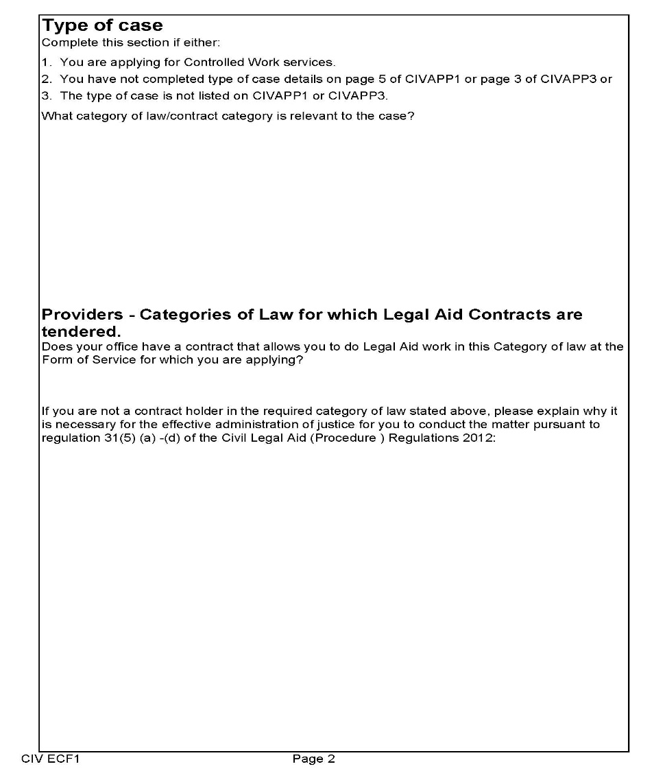
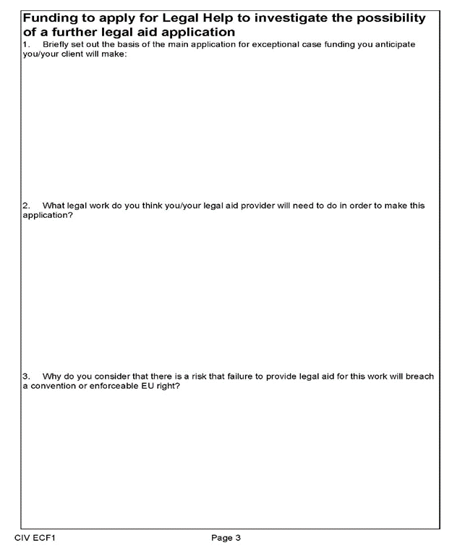
Practicalities – Form ECF1
Simon Mullings
@spikemullings

Slide 35
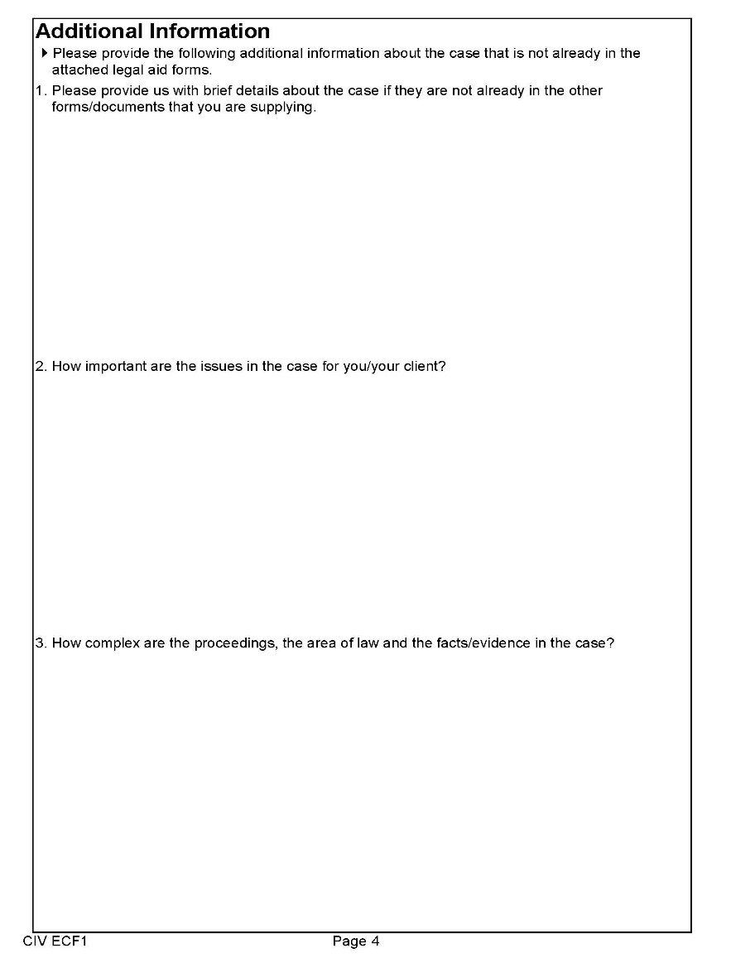
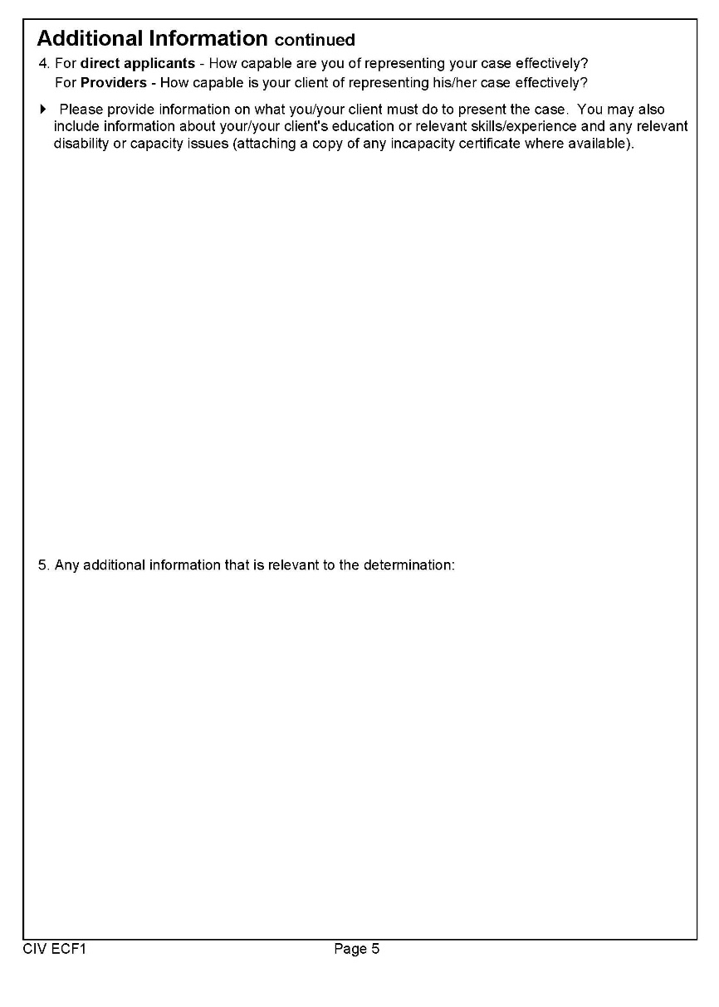
Practicalities – Form ECF1
Simon Mullings
@spikemullings

Slide 36
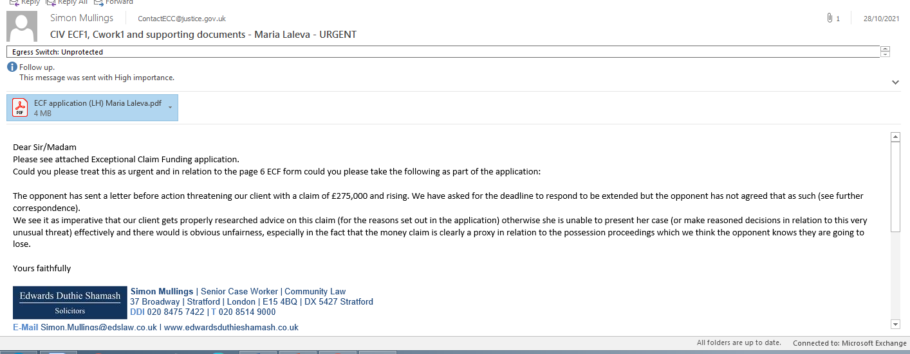
Practicalities – Legal Help
Simon Mullings
@spikemullings

Slide 37
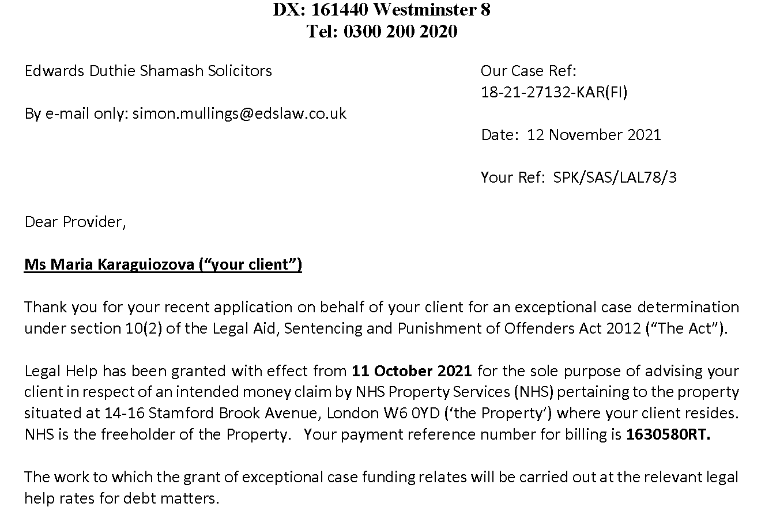
Practicalities – Legal Help
Simon Mullings
@spikemullings

Slide 38
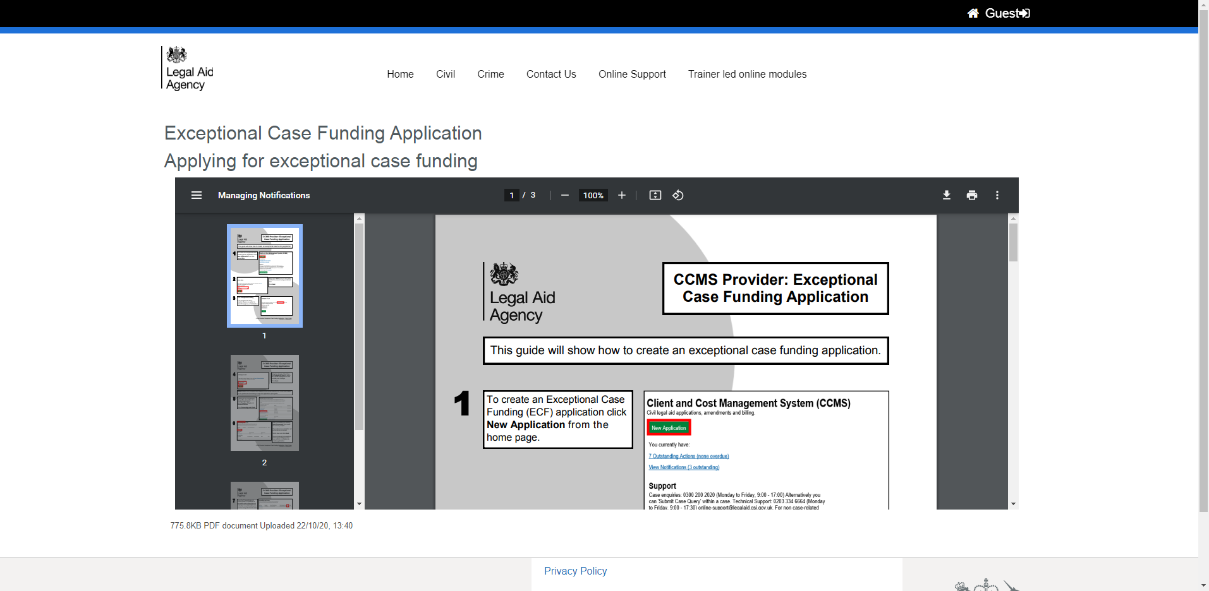
Practicalities - CCMS
Legal Representation (certificate)
https://legalaidlearning.justice.gov.uk/mod/resource/view.php?id=88
Simon Mullings
@spikemullings

Slide 39
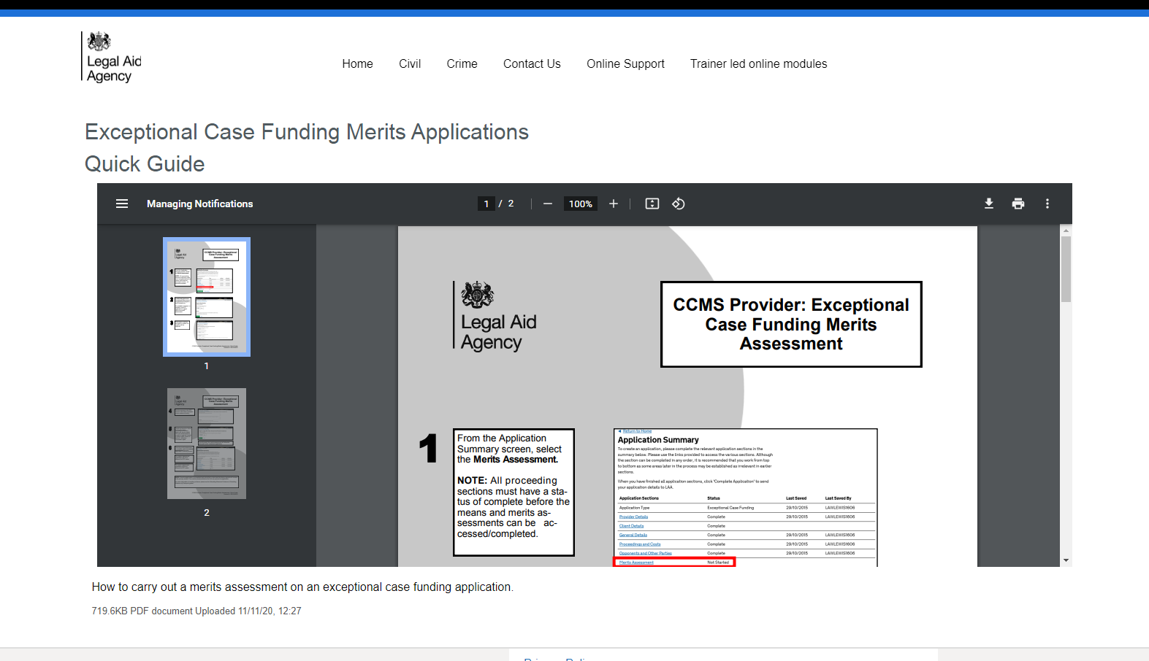
Practicalities - CCMS
Legal Representation (certificate)
https://legalaidlearning.justice.gov.uk/mod/resource/view.php?id=130
Simon Mullings
@spikemullings

Slide 40
Practicalities
Main 3 breaches/potential breaches you are looking at in order to get funding under s10 of LASPO for a WB case will be Art 6 and Art 8 ECH. Also Art 47 of the Charter of Fundamental Rights of the EU – provides that legal aid should be made available in so far as it is necessary to ensure effective access to justice. Most WB cases you will be looking at Art 6 – right to a fair hearing. But worth considering Art 8 in appropriate cases (eg where at risk of losing a home) or A1P1 (right to peaceful enjoyment of possessions).
Under Art 6 you are arguing that without representation your client would not be able to present their case effectively and without obvious unfairness (see Gudanaviciene). Test is essentially the same in Art 8 and Art 47 cases, but Article 8 is broader in that you do not need to be before a Court.
In an Art 6 case you can get funding before the case goes to the FTT –once there has been a negative decision you can get involved at the MR/review stage if appropriate. This is because for Art 6 there must be a determination of a civil right. Cases in which an applicant must exhaust a preliminary administrative remedy under national law (like the MR / review process) have been held to engage Article 6 (e.g. Konig v Germany (No. 1) (A/27) (1978)2 EHRR 170 PC). This is useful to quote for why you want funding at an earlier stage than an appeal in a relevant case. Also has stuff on “reasonable time” – ie obligation on governments to organise judicial system so people can have their disputes over civil rights and obligations determined within a reasonable time. There are often delays in the MR process, which can justify legal aid at this stage to make reps. I have got ECF on several occasions for assistance at the MR stage.
Simon Mullings
@spikemullings

Slide 41
Practicalities
You might think that Art 47 cases will be much less due to Brexit. The Immigration (EEA) Regs 2016 have been repealed (ie the domestic regs that implement free movement law). However, these Regs continue to have effect in various situations post Brexit, mainly in relation to people who were here prior to 31.12.2020 and have applied for settled or pre-settled status.
Having thought about it a bit more, not sure a DHP would work for ECF, certainly not under Art 6. This is because there is no guarantee to the benefit if you meet the criteria, unlike say JSA, UC, IS, ESA etc. Due to the discretionary nature of the benefit it is not likely to come within definition of “determination of a civil right”. That said, if the client is facing loss of home you might get it under Art 8 perhaps. This would only be for preparation of the application, or perhaps the review process. Once you’ve exhausted that then you’re in JR territory and thus in scope (probably requires a public law contract but you might be able to argue it is a housing related JR and do it under a housing contract in the same way you’d do a s188(1) JR etc). Osbornes have run several successful DHP JRs over the years. See also paras 64-65 of the Lord Chancellors Guidance on this issue re what is a determination of a civil right.
Simon Mullings
@spikemullings

Slide 42
Practicalities
On complexity WB cases put you in a good position to get funding as most cases are complicated. It is well recognised that WB law is super complex. The Courts have recognised the complexity of Social Security Law on numerous occasions For example, in the case of R (Veli Tum) Secretary of State for the Home Department (2004) EWCA Civ 788, in respect of the applicability of the law relating to EEA nationals and entitlement to Income Support, Lord Woolf stated the following:
  “The provisions are labyrinthine, but to cut a convoluted story short, she was a person from abroad, pursuant to paragraph 17 of Schedule 7, to the Income Support (General) Regulations 1987, and although her present in this country was lawful – unless and until removal pursuant to regulation 2(3) of the Immigration (European Economic Area) Regulations 2000 – she did not enjoy the right to reside here at the material time because she was not a “qualified person” as defined by regulation 5 of the 2000 Regulations
The LC guidance is also helpful on such cases providing as follows at para 66:
  “In relation to the complexity of the case, is the case simply about satisfying entitlement rules or straightforward factual issues such as an alleged delay in making an application? On the other hand, does the case concern complex legal issues about the interaction of retained EU and domestic law or complex immigration matters?”
However, you can also argue other cases are complex under benefits – there may be factual complexity if there is a complex history or a lot of evidence is required to be marshalled.
Simon Mullings
@spikemullings

Slide 43
Practicalities
On importance of the issue at stake you are also generally on solid ground. There is often little more important than the basic living allowance that you get paid by the state if you rely on it. How else do you feed and clothe you and your family if you cannot work? Equally, disability benefit entitlement raises very important issues. It is nearly always going to be worth addressing this point in a WB case.
On the ability of the applicant to represent themselves, there is a bit of a cross over with complexity. In a really complex EU right to reside case unless your client happens to be a professor of EU law I think you can argue pretty much anyone is going to struggle to represent themselves. However, often you are also dealing with vulnerable clients eg no English as a first language, disabled etc. In such cases my view is that you can make an argument to get ECF in much more straight forward WB cases. For example I managed to get ECF for a fairly run of the mill ESA claim – ie just arguing that he met the relevant points. But the client was exceptionally vulnerable and had attempted suicide after failing to attend the hearing of his appeal as he was so stressed. We managed to get funding and got the case re-heard and (surprise surprise) he was entitled to ESA. The legal issues were not complicated but the client’s ability to represent himself was massively limited. It also tied in with the importance of the issue to him, as he was reliant on ESA to meet basic needs. This is an extreme example, but it should be possible to get ECF for more straight forward WB appeals where you have a vulnerable client.
Another tip is to remember to address the usual criteria for legal aid – I have had cases where the LAA has just decided that the case does not have merit. So consider potential sources of funding, and sufficient benefit to the individual.
Simon Mullings
@spikemullings

Slide 44
Practicalities
Instructing Counsel under Legal Help - paragraphs 3.58 to 3.61 of the Standard Civil Contract Specification :
3.58 Where you instruct Counsel under Legal Help in a case that is covered by a Standard Fee, you are responsible for agreeing Counsel’s fees and paying them out of the Standard Fee. Counsel’s fees under Legal Help do not count as a disbursement unless the case escapes from the relevant Standard Fee and may not be taken into account in determining whether a case escapes from that fee.
3.59 If you instruct Counsel under Legal Help and the case escapes from the Standard Fee you may, when claiming your fees on the basis of Hourly Rates, Claim payment from us of Counsel’s fees as if such fees were a disbursement incurred by you. The Hourly Rates set out in the Remuneration Regulations shall not apply to Counsel’s fees claimed under this Paragraph 3.59.
3.60 Where you claim Counsel’s fees under Paragraph 3.58 to 3.59
  (a) you must record the justification for the instruction of Counsel in terms of the complexity or other exceptional circumstances of the case and the relevant expertise of Counsel;
  (b) Counsel must set out details of the time spent in their invoice; and
  (c) you must pay Counsel the full fee stated in Counsel’s invoice and claimed from us, irrespective of any reduction in respect of Counsel’s fees on assessment.
Simon Mullings
@spikemullings

Slide 45
What to do if your application is refused
Applicants can apply to the LAA within 14 days for an internal review of a refusal to grant ECF
Use form APP9E, which should be supplied with any refusal
LAA aims to process applications for internal review within 10 working days
No further right of review; a refusal to grant ECF on internal review can only be challenged by judicial review
Simon Mullings
@spikemullings

Slide 46
Further resources
Form ECF1: https://assets.publishing.service.gov.uk/government/uploads/system/uploads/attachment_data/file/879163/CIVECF1_form_fillable.pdf
Lord Chancellor’s Guidance: https://www.gov.uk/government/uploads/system/uploads/attachment_data/file/477317/legal-aid-chancellor-non-inquests.pdf
Provider Information Pack: https://assets.publishing.service.gov.uk/government/uploads/system/uploads/attachment_data/file/879071/ECF_Provider_Pack_March_2020_Amendments__002_.pdf
Simon Mullings
@spikemullings

Slide 47
Further resources
PLP guide to accessing ECF: https://publiclawproject.org.uk/exceptional-case-funding/
Legal Aid, Sentencing and Punishment of Offenders Act 2012 - Section 10: https://www.legislation.gov.uk/ukpga/2012/10/section/10
The Civil Legal Aid (Procedure) Regulations 2012 No. 3098 - Part 8: https://www.legislation.gov.uk/uksi/2012/3098/part/8
Simon Mullings
@spikemullings

Slide 48

Further resources
Simon Mullings
@spikemullings

Slide 49
Further resources https://legalaidlearning.justice.gov.uk/
Simon Mullings
@spikemullings

Slide 50
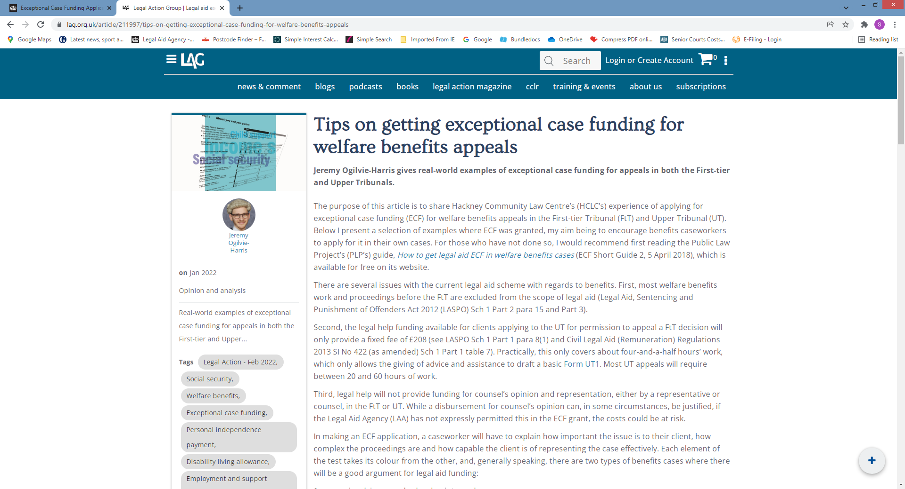
Further resources
https://www.lag.org.uk/article/211997/tips-on-getting-exceptional-case-funding-for-welfare-benefits-appeals
Simon Mullings
@spikemullings

Slide 51
Further resources
https://www.lag.org.uk/article/211997/tips-on-getting-exceptional-case-funding-for-welfare-benefits-appeals
In making an ECF application, a caseworker will have to explain how important the issue is to their client, how complex the proceedings are and how capable the client is of representing the case effectively. Each element of the test takes its colour from the other, and, generally speaking, there are two types of benefits cases where there will be a good argument for legal aid funding:
1 cases involving complex legal points; and
2 cases where the appellant is unable, for a variety of reasons, to effectively put their case and respond to the benefit authority’s case.
Complex points of law in FtT appeals
Complex FtT appeals
The complexity of proceedings and the capability of the individual to represent themselves are interlinked. This means that there may be ‘ordinary’ benefits appeals that warrant an ECF application.
Personal circumstances
It is also possible to obtain ECF legal help for cases where the proceedings may not be particularly complex but the appellant is unable to represent themselves for other reasons, such as limited English skills or learning disabilities.
Permission to appeal to the UT
Complex points of law in UT appeals
Simon Mullings
@spikemullings

Slide 52
DISCCUSION AND
ANY QUESTIONS?
Simon Mullings
@spikemullings

